Slide 1

Role of Information and Communications Technology (ICT) for Multi Modal Transport
Rajnish Kumar
Professor IT,
National Academy of Indian Railways
pit@nair.railnet.gov.in

Slide 2


We will discuss
Existing applications for core operations
Technology Trend
Future of things

Slide 3
Historical Application of ICT
Historically, the use of ICT in transport and logistics started in the 1960s.
Typical examples are
  inventory management systems,
  transport routing,
  scheduling, also known as Distribution Requirement Planning, and
  billing systems

Slide 4
Historical Application of ICT..2
Material Requirements Planning(MRP)
and
Manufacturing Resource Planning (MRP II)
And then EMERGED
Enterprise Resource Planning(ERP)

Slide 5
ENABLING TECHNOLOGIES
Cloud Computing
Wireless communication technologies (such as smart mobile phones, QR code, RFID and telematics tracking).
Switching from dyadic one-to-one communication to simultaneous one-to-many communication changes the way supply chains are structured and information is shared

Slide 6
Proper categorisation of ICT functions
REF: Giannopoulos (2004) Three functions are described below.
Transportation resource management This function is related to the control of transportation resources such as load units, trucks, trains, ships and containers.
Ports and terminals operations management: This function enables the control of the flow of material through the ports and terminals.
Freight and vehicle tracking and tracing: This function enables the monitoring and control of the location of vehicles and freight in the transportation network.

Slide 7
“eFreight” Present day problems
Complexity of freight transport information exchange in the context of multimodal transport:
Problems
Result
  • lack of interoperability along the supply chain
  • operators provide information several times for different purposes
  • lack of information on intermodal availabilities
  inefficiencies, costs, reduced visibility of freight
administrative costs + perceived complexity for multimodal transport
  no full exploitation of multimodal transport / non-optimization of use of existing transport infrastructure
  Thus there is need for interoperable interfaces for information on freight in the various transport modes

Slide 8
“eFreight”: The vision of EU
• Interoperability between paperless freight information systems
• Zero paper documents needed for planning, executing and completing any transport operation within the EU
• Reduced waiting time at hubs related to administrative procedures
• Standard framework for intermodal information exchange
• Harmonised border crossings

Slide 9
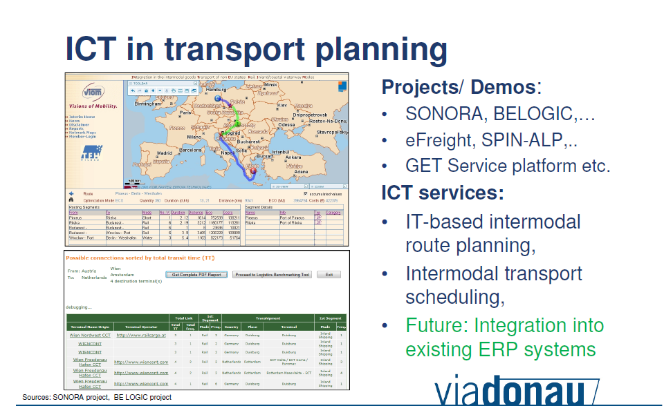

Slide 10
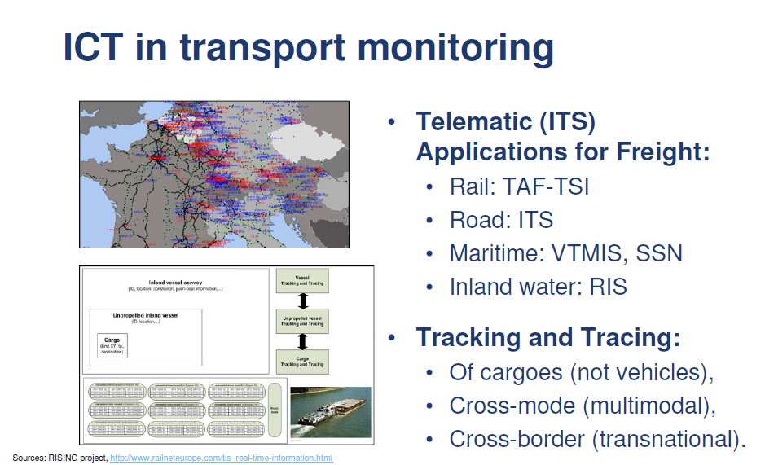

Slide 11
Intelligent Transport Systems (ITS)
ITS in the field of transport
• Providing real-time traffic information,
• Supporting traffic safety and transport operations etc.
EXAMPLES of ITS in the field of transport:
• Road intelligent transport systems (ITS),
• Air traffic management system (SESAR),
• European rail traffic management system (i.e. ERTMS) and
rail information systems (i.e. TAF-TSI),
• Maritime surveillance systems (SafeSeaNet et al.), VTMIS
(Vessel Traffic Management and Information System and
• Inland navigation (River Information Services [RIS]).

Slide 12
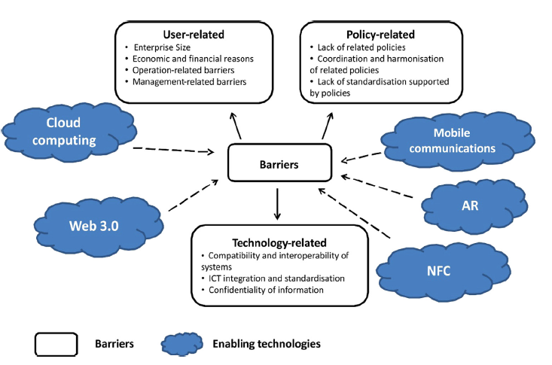
Barriers to Adoption of Technology
REF: KOMODA, 2009. KOMODA: Co-modality – Towards Optimised Integrated Chains in Freight Transport Logistics Deliverable D3.2: Action Plan. European Commission within the Seventh Framework Programme (2007–2013).

Slide 13
ICT in Indian Railways
Basic

Slide 14
CENTRE FOR RAILWAY INFORMATION SYSTEMS (CRIS)
The Centre for Railway Information Systems (CRIS), an autonomous Society under the Ministry of Railways set up in 1986, plays the role of the Information Technology arm of the Indian Railways.
CRIS develops and maintains the major information systems deployed in the Railways, e.g. passenger ticketing, freight and passenger train operations, management of train crews, and management of fixed and rolling railway assets.

Slide 15
Freight/Operations Applications
Freight Operations Information System (FOIS), Terminal Management System (TMS) and E-Payment- About 2.9 million tonnes of freight are booked daily in FOIS.
Nearly 1,600 Railway Receipts (RRs), amounting to about Rs 255 crore, are generated, constituting 99.9% of freight booked; approximately Rs 191 crore (75% of total) is collected through e-payment every day.

Slide 16
Freight/Operations Applications
FOIS Rake Management System (RMS)-
About 4,353 rakes are monitored daily through this module. Loads on the run / consignments in transit can be tracked by the customers on FOIS-Web.
The Rake Allotment System provides optimum allocation of rakes for efficient freight movement.

Slide 17
Freight/Operations Applications..contd
Control Office Application (COA) and Timetable Management System (Satsang)-About 5,00,000 arrival/ departure events of 14000 trains are recorded each day in 77 control offices through COA.
Satsang assists in the preparation of train timetables to optimize running of trains.

Slide 18
Freight/Operations Applications..contd
Crew Management System (CMS)-362 lobbies are provided with CMS.
The system serves 47,000 calls daily via SMS, enabling train crews to sign on and sign off at CMS kiosks.

Slide 19
Freight/Operations Applications..contd
Locomotive Management System (LMS for Diesel Locomotives) and SLAM (for Electric Locomotives) (Software for Locomotive Asset Management)
  These applications, presently implemented at a few sheds, will ultimately manage the maintenance of over 10,000 locomotives
Coaching/Freight Maintenance Management System (CMM/FMM)
  These applications, presently implemented at pilot locations, will manage the maintenance of 60,000 coaching vehicles and 2,50,000 wagons.

Slide 20
Freight/Operations Applications..advantages
These applications provide convenience and transparency for the Freight Customer.
They also ease the work of the Railway staff, improving overall efficiency.
Section controllers – reduced fatigue and stress through COA
Running staff – optimized crew rotation and automatic mileage calculation through CMS

Slide 21
Freight/Operations Applications..advantages
Track maintenance staff – easier maintenance of records through Track Mgt System
Locomotive maintenance staff– information at fingertips through SLAM, LMS
Planners – Rake Allocation System of FOIS assists in optimal allotment of rakes

Slide 22
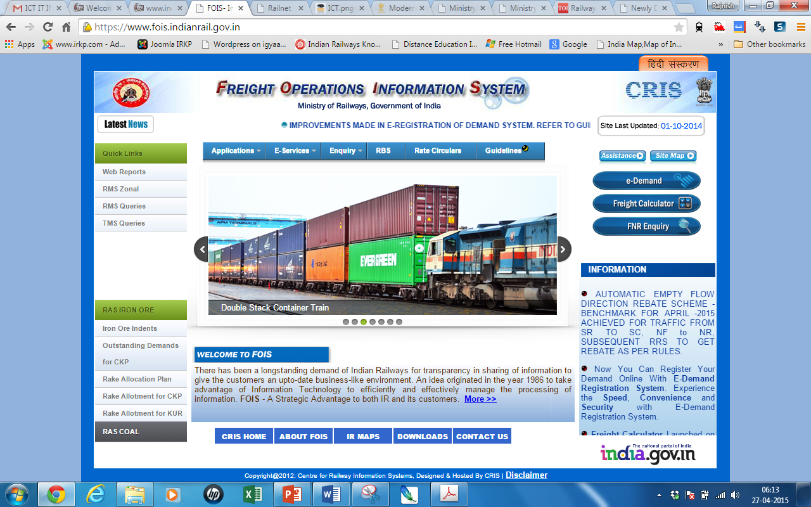
FOIS - https://www.fois.indianrail.gov.in/

Slide 23
Advances in interface technologies
The latest development of augmented reality(AR)technology
Augmented reality (AR) is a live direct or indirect view of a physical, real-world environment whose elements are augmented (or supplemented) by computer-generated sensory input such as sound, video, graphics or GPS data.

Slide 24
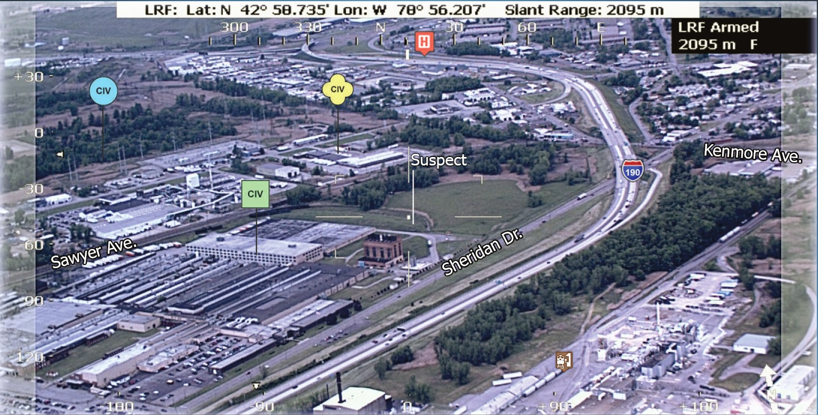
Policing Function

Slide 25
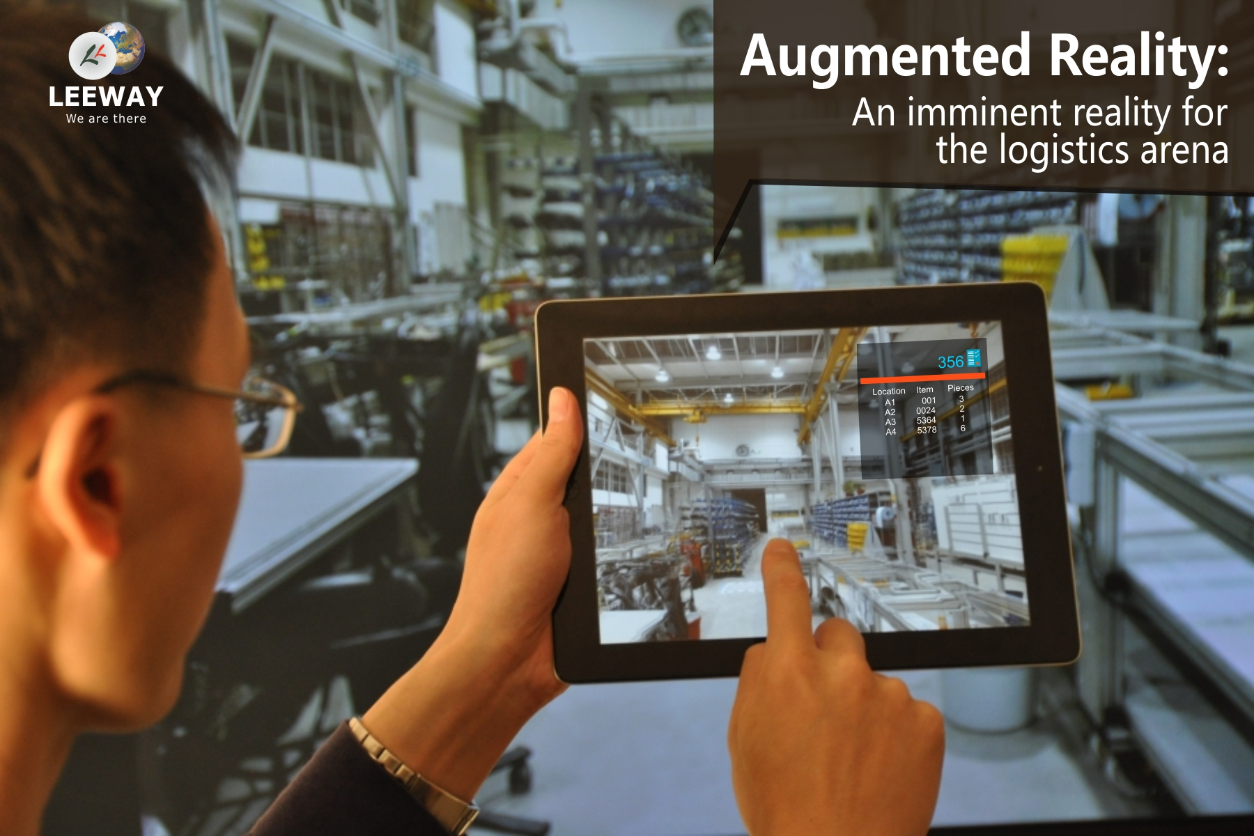

Slide 26
Application of Technology
Examples from DHL
Vision Picking at DHL - Augmented Reality in Logistics - https://www.youtube.com/watch?v=I8vYrAUb0BQ
DHL Supply Chain's Service Logistics innovation-https://www.youtube.com/watch?v=kbFbsaLmFrw
http://www.dhl.com/content/dam/downloads/g0/about_us/logistics_insights/csi_augmented_reality_report_290414.pdf
http://www.dhl.com/content/dam/downloads/g0/about_us/innovation/CSI_Studie_BIG_DATA.pdf

Slide 27
Monitoring Mechanisms
Some technologies like
RFID
NFC
QR Code

Slide 28

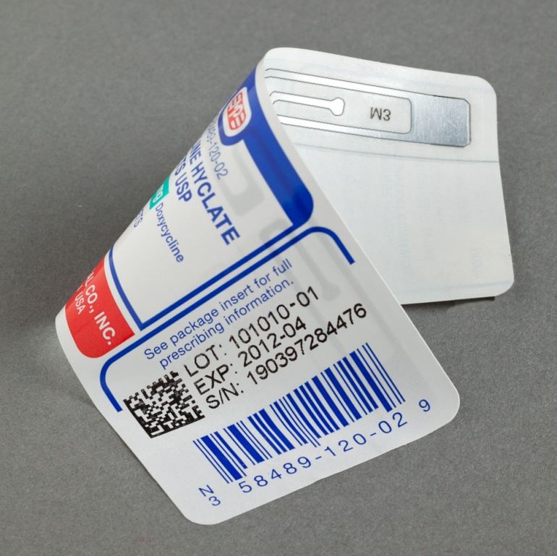
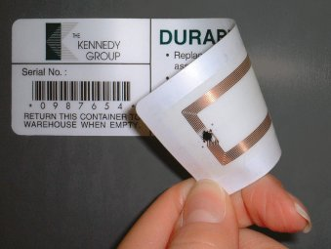
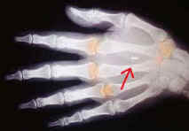
RFID
Radio-frequency identification (RFID) is the wireless non-contact use of radio-frequency electromagnetic fields to transfer data, for the purposes of automatically identifying and tracking tags attached to objects.

Slide 29

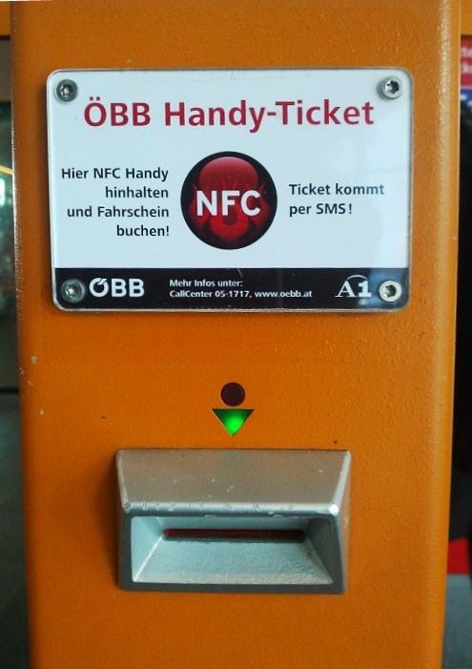
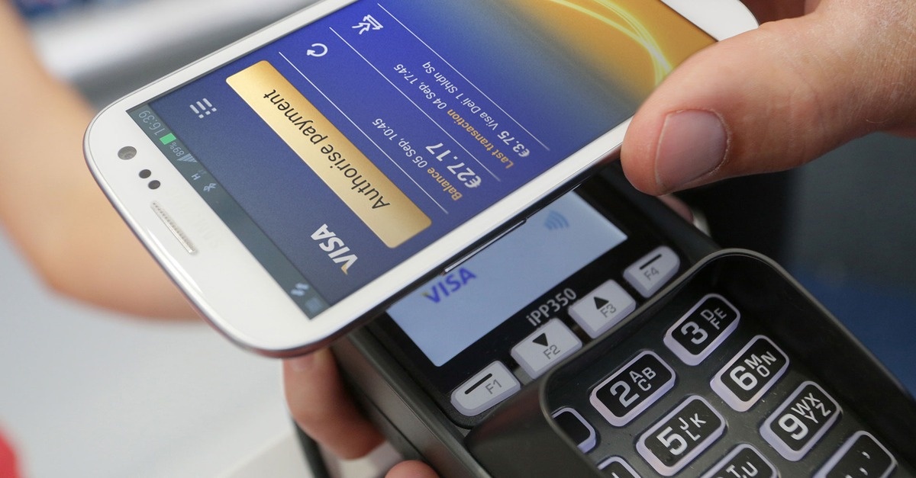
NFC
Near field communication (NFC) is a set of standards for Smartphone and similar devices to establish radio communication with each other by touching them together or bringing them into proximity, usually no more than a few centimetres.
List of applications of near field communication

Slide 30

QR Code
The QR (Quick Response) Code is a two-dimensional (2-D) matrix code that belongs to a larger set of machine-readable codes, all of which are often referred to as barcodes, regardless of whether they are made up of bars, squares or other-shaped elements.
http://www.nacs.org/LinkClick.aspx?fileticket=D1FpVAvvJuo%3D&tabid=1426&mid=4802

Slide 31
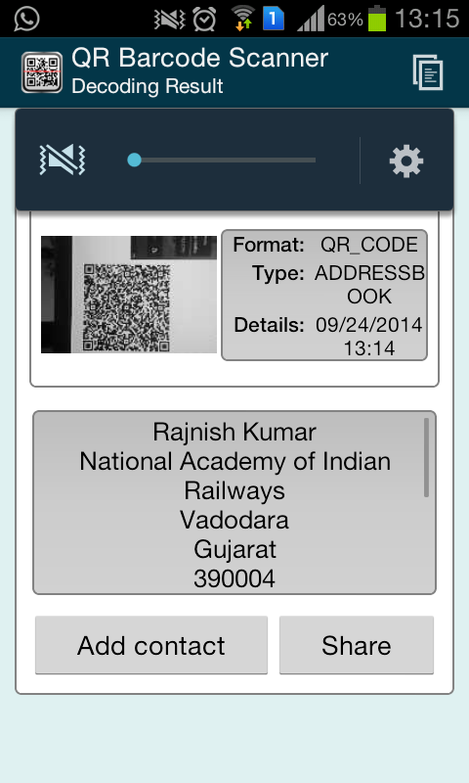
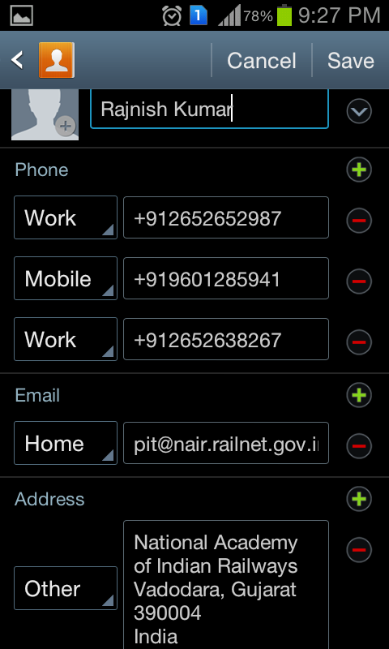

Example of QR Code

Slide 32
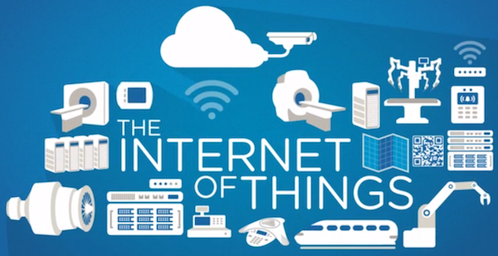
The future

Slide 33
What is IoT?
The Internet of Things (IoT) has been defined by International Telecommunication Union in Recommendation ITU-T Y.2060 (06/2012)
The IoT is a “network” of ‘things’ that can broadcast data and connect to the internet or to a network.
Objects, animals or people are given unique identifiers and the capability to transfer data over a network.
The convergence of wireless technologies, micro-electromechanical systems (MEMS) and the Internet leads to IoT.

Slide 34

Potential of IoT –
Internet of Things
According to Gartner, by the 2020, there will be 26 billion devices connected to the internet, with 10 billion already connected.
Gartner further estimates that IoT products and services will generate revenue exceeding $300 billion in 2020. IDC on the other hand has forecast that the worldwide market for IoT solutions will grow to $7.1 trillion in 2020.

Slide 35
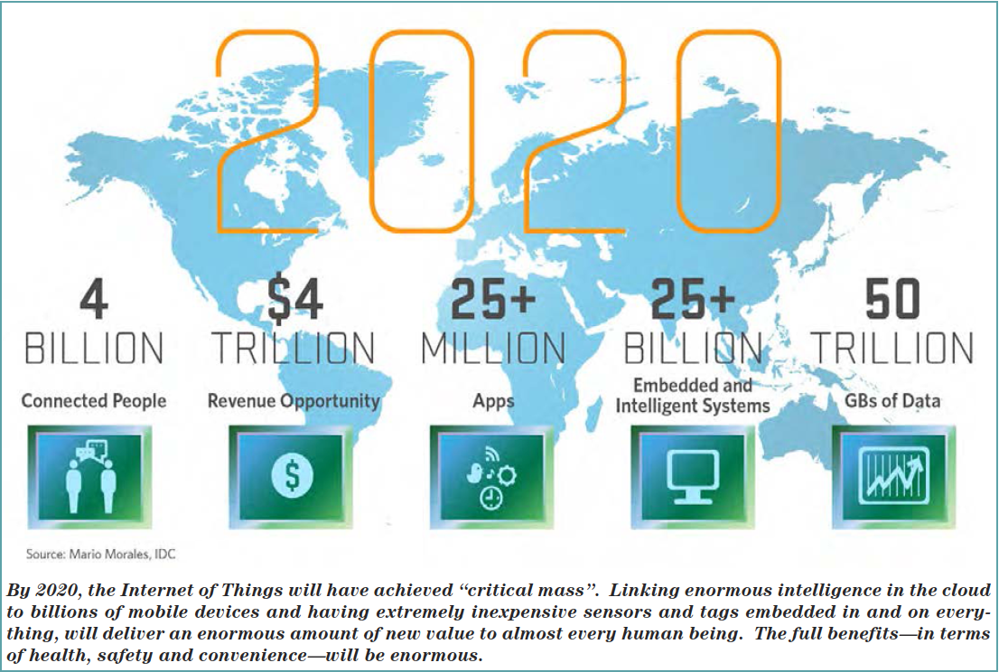

Slide 36
Real life Example of IoT

Slide 37

302, shivalik complex, amikunj cross coads, naranpura, ahmedabad – 380013, gujarat ,India
infor@locanix.com ● www.locanix.com

Slide 38

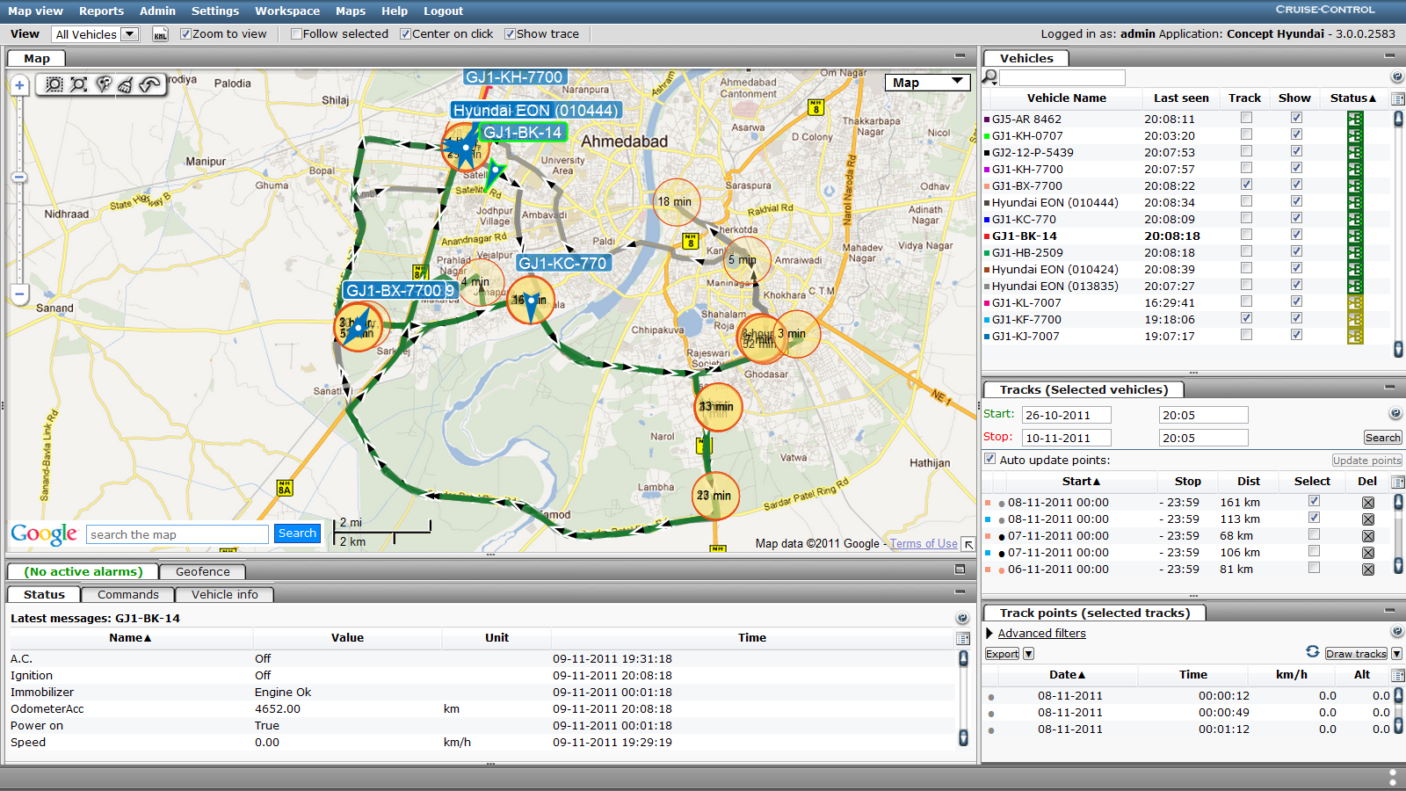

Cold-Storage and Supply-Chain Management

Slide 39
Key Goals
Real-time monitoring of Cold-storages
Regular Performance Feedback
Business Integration
Advanced Reporting
Complete Supply Chain Management System under one single umbrella

Slide 40
Cold-Storage – Technology Specifications
Very Specialized Temperature Technology
Completely Digital Temperature sensing Technology
Measurable Temperature Range : ‐55°C ~ +125°C (‐67°F ~ +257°F)
Accuracy : ±0.5°C @ ‐10°C ~ +85°C
Maximum Resolution : 0.0625°C
Very Stable Technology: Once installed, does not require any kind of maintenance or services

Slide 41
Cold-Storage - Technology Specifications
Real-time Temperature Data Collection @ 1 minute interval.
Data-logging can be done for more than 90 Days.
Daily Data Logs can be stored in separate Cold-storage wise folders and can be emailed respective supervisors and cold-storage managers.

Slide 42
Cold-Storage - Security
Role-based Access authorization for all cold-storages.
Havmor Can see all Cold-storages
RSM Wise Acces
Territory Wise Access

Slide 43
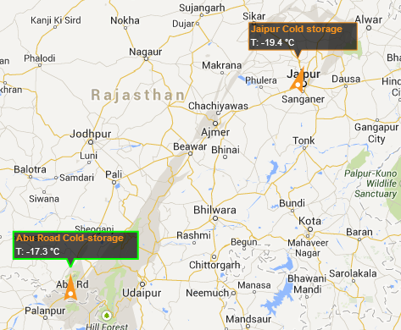
Cold-Storage - Real-Time View
Specialized View for monitoring of the Cold-storages.
You can see your complete supply-chain cold-storages in singe view on the map.

Slide 44
Cold-Storage - Temperature Drop during Unloading
Cold-storage systems can be integrated with Havmor Transportation System.
System Reports Average Temperature during Vehicle Unloading.
Based on that we can find “Temperature-drop” factor during Vehicle Unloading.
Special report for UNLOADING EVENT can be designed which will show
TEMPERATURE_AT_START, TEMPERATURE_AT_END and AVG_TEMPERATURE_DURING_UNLOADING

Slide 45
Cold-Storage - RSM and Supervisor Performance
It is also possible to find which Cold-storage staff takes more time for UNLOADING and which Cold-storage staff takes less time for unloading
Sometimes vehicle spend unnecessary time for unloading because of which the supply is affected.
Optimization on “Average-Unloading-Time” per vehicle can drive effective utilization of the Existing Resources

Slide 46
Cold-Storage - RSM and Supervisor Performance
Temperature Drop Event: As soon as the cold-storage reaches and remains under thrash-hold temperature drop condition, An event or alarm can be raised on the server.
Supervisors are immediately notified of any such event.
Most Importantly, A report is prepared every month automatically that shows how many times all cold-storages have caused Temperature Drop conditions.
Havmor can find such Cold-storages and take necessary actions.

Slide 47
Cold-Storage – Preventive Measures
If units are disconnected or Temperature sensor is disconnected inside the Cold-storage, an alert can be raised on the server with actual time of disconnect.
Supervisors are immediately notified of any such event.

Slide 48
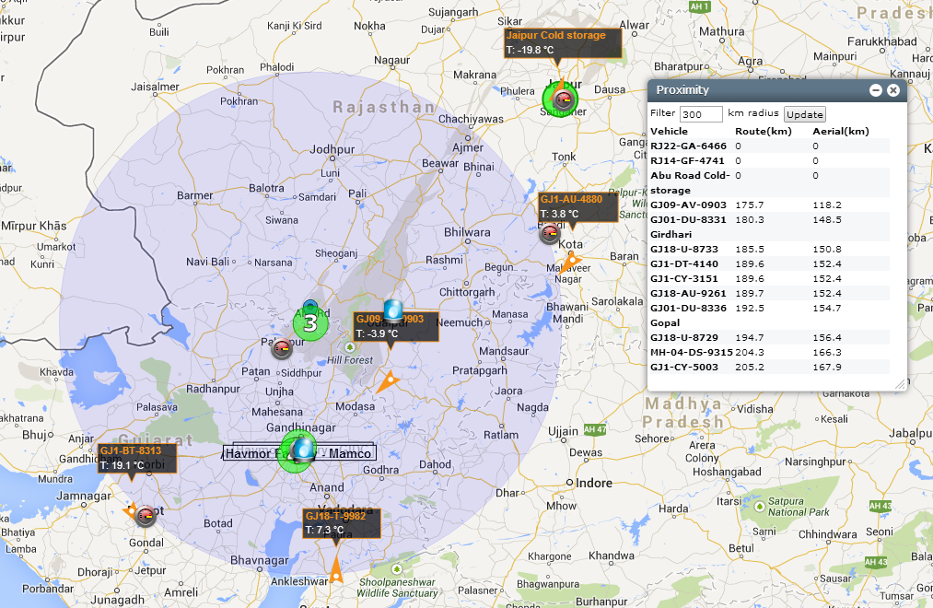
Cold-Storage – Advanced Supply Chain Management
For Ex: This screen shows all vehicles in 300 Km. proximity of the ABU ROAD Cold-storage.

Slide 49
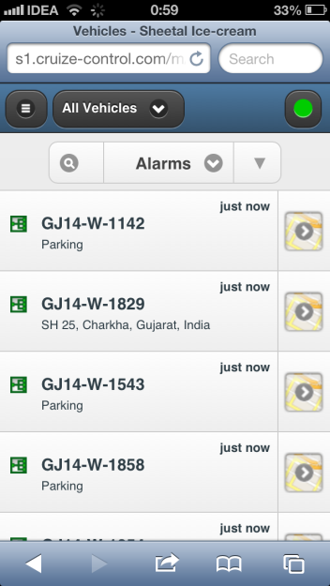
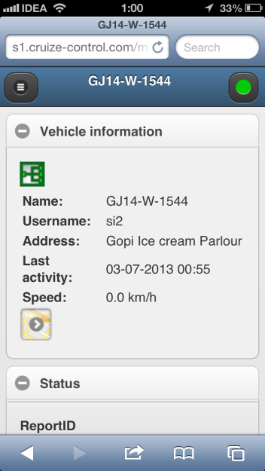
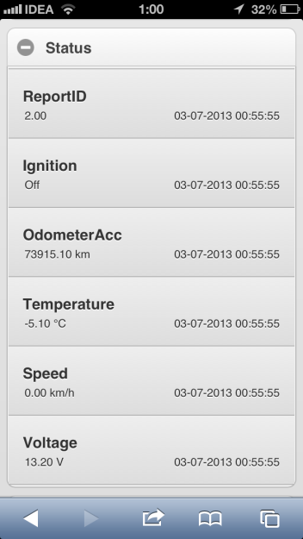
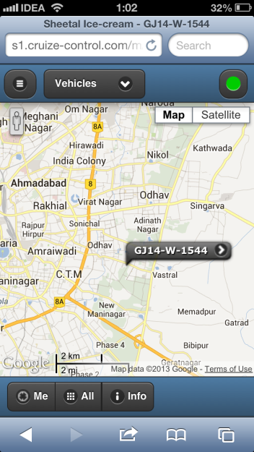
Cold-Storage – Advanced Supply Chain Management
Locanix FMS operates out of enterprise grade cloud infrastructure
Reach out to your Cold-storages from any internet connected device
No need to install any software anywhere

Slide 50
Cold-Storage – Endless Reporting Possibilities
Automatic report generation and delivery of Reports will significantly boost the productivity of your supply chain management staff and let them focus on more important matters at work then just downloading reports.
All reports automatically delivered to Email Inbox every day based on prescribed delivery schedule.
Excel, PDF, HTML, Graph Reports
“Sealed-Reports” – Once generated can not be altered or changed

Slide 51

Big Data
Big data is a term for data sets that are so large or complex that traditional data processing applications are inadequate. Challenges include analysis, capture, data curation, search, sharing, storage, transfer, visualization, querying and information privacy.

Slide 52
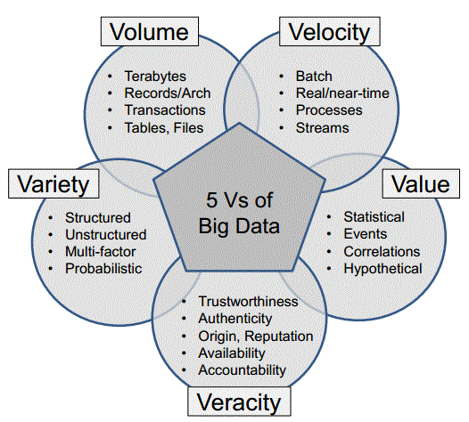
Big Data … just a little bit more!!!
Notes:
F. Big Data:
…plus one new recent addition:
Value: It is necessary that the information extracted from the mass of data provide a tangible benefit. For example, if a company can identify through statistical analyzes certain consumer trends, it can get a great advantage over your competitors.
Image: http://luizricardo.org/wordpress/wp-content/upload-files/luizricardo/2014/05/Big-Data-5V.gif

Slide 53



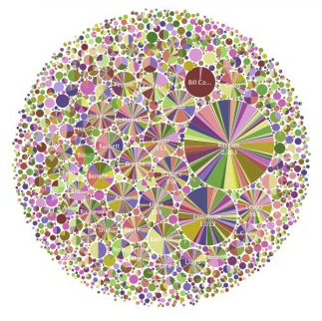

What is Analytics?
Mathematical or Scientific methods that highlight data for insight
Insight = Competitive Advantage
Used to inform actions and decisions
Data is becoming the world’s new natural resource
With analytics, insights are created to augment the gut feelings and intuition for decisions
Notes:
What is Analytics?
Analytics is any mathematical or scientific method that augments data with the intent of providing new insight.
Insight creates competitive advantage when used to inform actions and decisions
Data is becoming the world’s new natural resource, and learning how to use that resource is a game changer.
Through the use of analytics, insights from data can be created to augment the gut feelings and intuition that many decisions are based on today.
Scientific Method Image (swirl): Precession of the perihelion (exaggerated) taken from http://en.wikipedia.org/wiki/Scientific_method
Mathematical Method image (formula): Ratio test (also known as D'Alembert's criterion) from http://en.wikipedia.org/wiki/Convergence_tests
Insights Image (light bulb): http://blog.lab42.com/wp-content/uploads/2014/03/Insights-.jpg
Data image (sphere): https://www.ibm.com/developerworks/mydeveloperworks/blogs/iic-san-mateo/resource/BLOGS_UPLOADED_IMAGES/biginsights.jpg
Analytics image (group of charts): http://asmarterplanet.com/mobile-enterprise/files/mobile-analytics.png

Slide 54
Big Data & Analytics
A great example of Visualization
Hans Rosling's 200 Countries, 200 Years, 4 Minutes - The Joy of Stats - BBC Four
Link to Video
https://youtu.be/jbkSRLYSojo

Slide 55
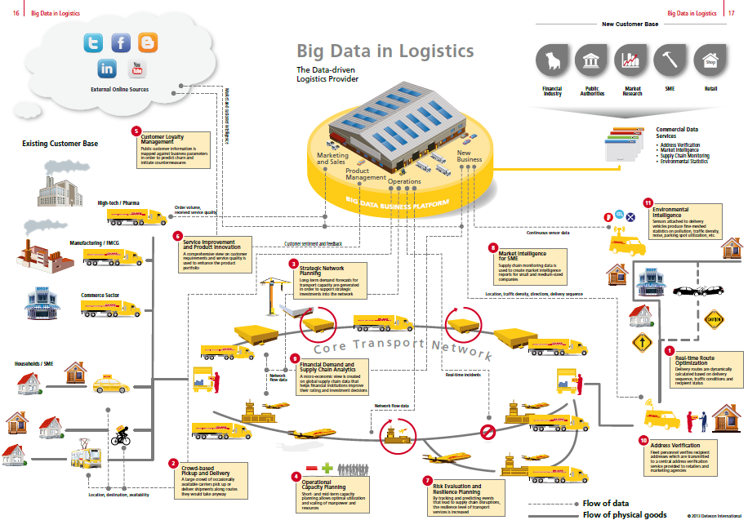
http://www.blue-yonder.com/blog-e/wp-content/uploads/2014/08/dhl_2.jpg
http://www.dhl.com/content/dam/downloads/g0/about_us/innovation/CSI_Studie_BIG_DATA.pdf

Slide 56
Big Data Potential
In addition to data fusion, there is process fusion—such as standardizing processes and understanding the various interlinked processes.
This provides operations visibility across the entire process chain, which can improve all logistics-related functions, such as:
Distribution center sort optimization
Back-haul activities
Revenue and fuel management

Slide 57
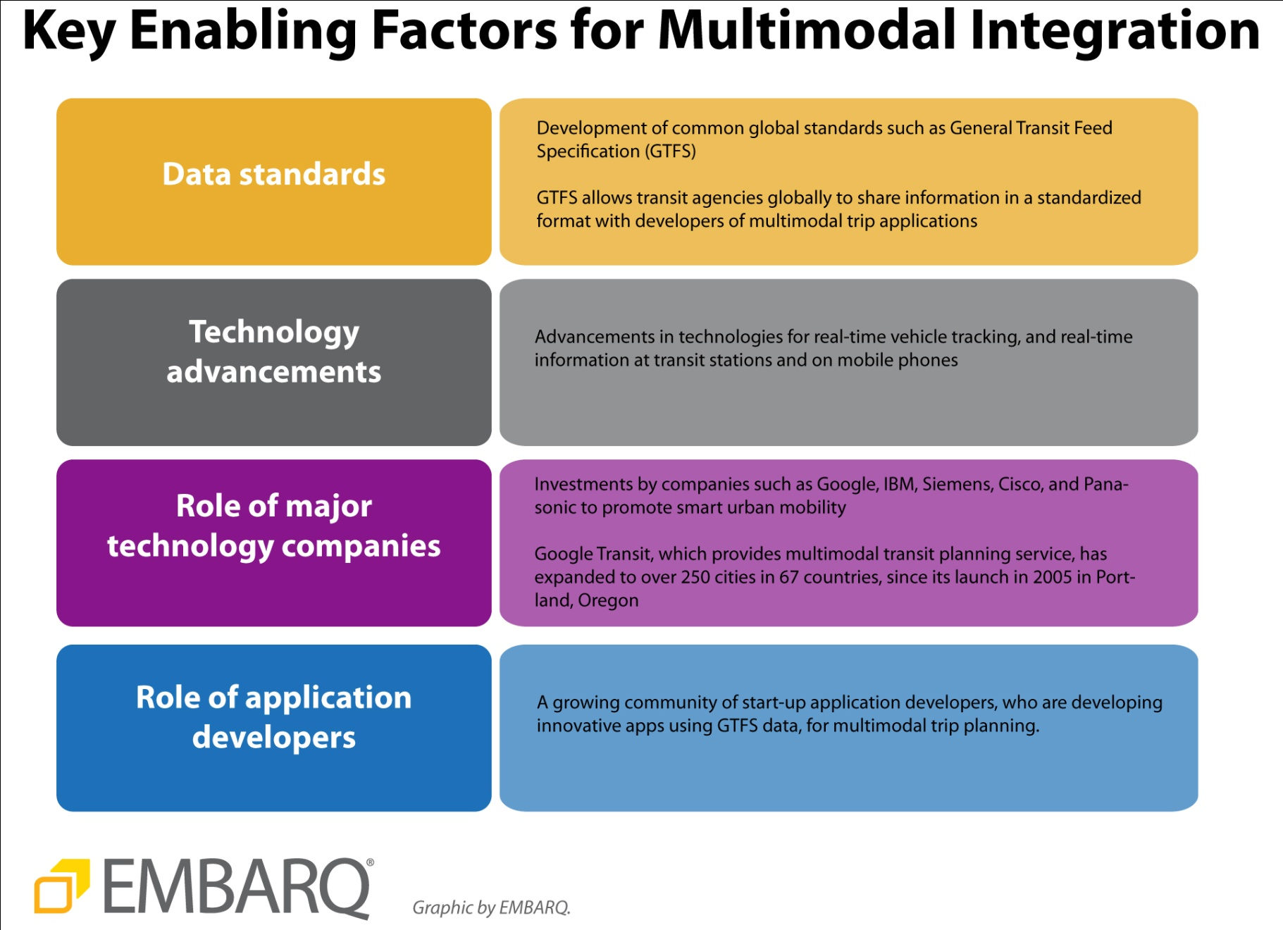

Slide 58
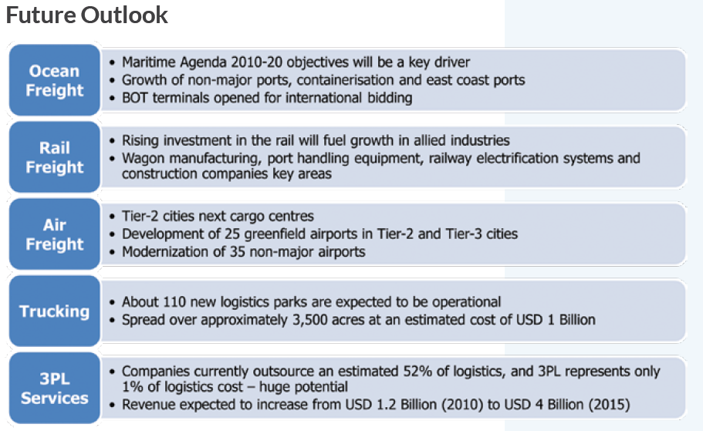

Slide 59
References
Irina Harris, Yingli Wang, Haiyang Wang, ICT in multimodal transport and technological trends: Unleashing potential for the future, International Journal of Production Economics, Volume 159, January 2015, Pages 88-103, ISSN 0925-5273, http://dx.doi.org/10.1016/j.ijpe.2014.09.005. (http://www.sciencedirect.com/science/article/pii/S0925527314002837) .
BELOGIC EU project: http://www.be-logic.info/
eFreight EU project: http://www.efreightproject.eu/
European Commission (DG MOVE): ICT for transport logistics in the White Paper context, ECITL 2011 (14
October 2011, Thessaloniki).
http://www.railneteurope.com/tis_real-time-information.html
RISING EU project: http://www.rising.eu/web/guest;jsessionid=73E0BFE8488F7FF97C2A0D7334FBFAE3
SONORA EU project: http://www.sonoraproject.eu/
WHITE PAPER Roadmap to a Single European Transport Area – Towards a competitive and resource
efficient transport system, Brussels, 28.3.2011, COM(2011) 144 final
Telematic Applications for Freight - Technical Specification for Interoperability (TAF – TSI)
http://www.worldbank.org/en/news/feature/2015/05/14/informationandcommunicationtechnologiesfacilitatetheevolutionoftransportsystems

Slide 60

Discussion

