Slide 1
Comparative Socio-Economic advantages of Rail
BIMSTEC Course
National Academy of Indian Railways
Vadodara
Sumant Chak
Asian Institute of Transport Development (AITD), New Delhi

Slide 2
Transport Choices
Transport an integral part of economic and commercial activities.
There are choices involved in respect of modes of transportation – rail, road, air, ship or even non-motorized transport.
Choice is driven by trade offs among prices, speed, safety, reliability and convenience for different modes.
Supply price in a modal transport market and users’ cost are the determinants of choice.

Slide 3
Effect of Transport on Nature
Transport activity causes stress on nature in the following ways:
  by drawing scarce resources – fossil fuel, minerals, various non-metallic minerals and other materials like sand, stones, etc. and by using land,
  by giving rise to wastes like pollutant gases, solid wastes, noise, etc. which all flow back to nature that acts as a sink to absorb them, and
  by partitioning or destroying the ecosystem of the neighbourhoods of transport operation like farm land, wildlife, habitats, etc.

Slide 4
Status of Rail traffic?
A number of countries have emphasised need for Railway to be the modal choice for mass transport
Rail despite support lags behind road in market share of freight and passenger
India has seen share of Rail in freight drop from 70% in 1970 to 24% in 2000 and passenger share from 36 % to 21 % in same period.
Why then the revival of rail across the world?

Slide 5
Real cost of Transport Modes
Rail is supposed to be superior mode of transport if we compare the true social costs of these two modes taking account of all the three segments of transport development.
Two reasons for variance:
(a) Distortion in price structure:
- Rail charges cover charges for both ground fixed infrastructure development as well as transport operation, while road transport charges do not properly reflect the road development charges.
(b) Environmental externalities are different between the two modes, and the environmental

Slide 6
Worldwide revival of Rail
Environment a huge and real concern now
Energy costs viewed as significant determinant of transport mode
Safety cost now being appreciated
Land usage a major factor in most countries
Public awareness and organisations pushing governments towards sustainable transport systems

Slide 7


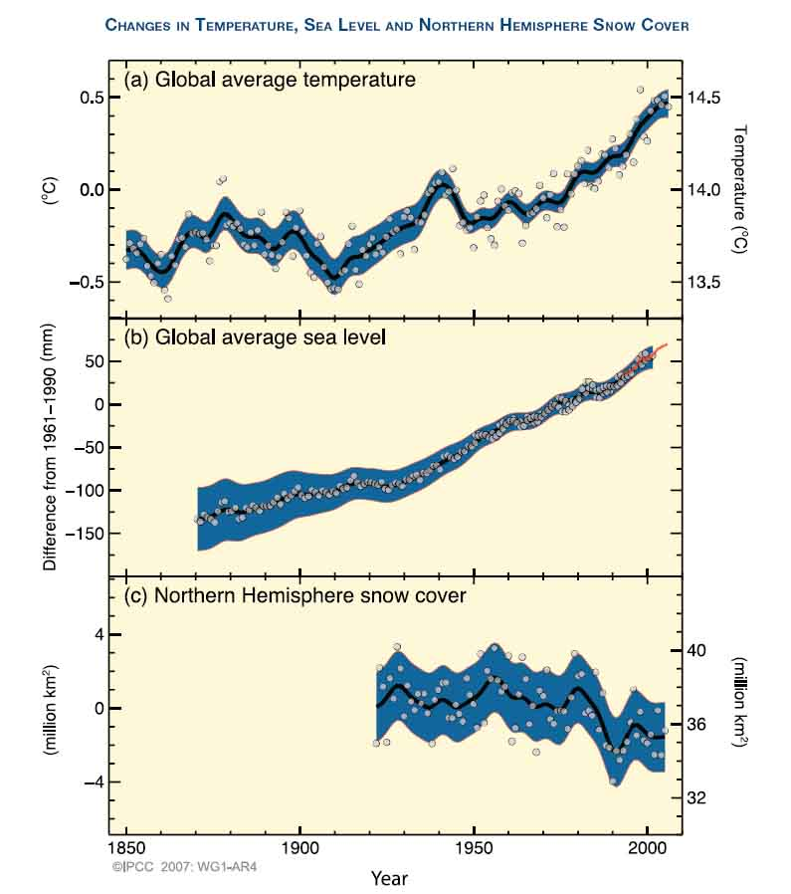
Climate Change
There is overwhelming scientific evidence that the global climate is changing. The world is getting warmer, sea levels rising and snow cover reducing.

Slide 8
Comparative Study of Rail and Road by AITD in 2002 - a milestone
Title of Study – “Environmental and Social Sustainability of Transport”
No study done earlier bringing together all costs including external costs of both modes
Methodology adopted provided acceptable results
Study provides insight for policy planners of the country – Modal choice clearly established
Based on socially optimal resource allocation
Evolves guidelines for price setting

Slide 9
Issues flagged in Study
Nature and Economy
Transport and Environment
Effects on Natural Resources
Effect on Urban Air Quality
Effect on Global Environment
Effects on Coastal and Marine Environments
Effects related to Disposal of Wastes

Slide 10
Development of Empirical model
The development of the empirical model was based on the using fixed values of traffic of one mode compared to the other – to work out energy consumed and polluting emissions with resultant health impacts and social costs – on the basis of the following:
- Representative sections
- Road traffic flows
- Rail traffic flows
- Energy consumption

Slide 11
Energy Consumption and Pollutant Emissions
The study focused on the following to obtain comparative data:
  - Energy consumption
  - Pollutant Emissions:
      Carbon Dioxide
      Carbon Monoxide
      Nitrogen Oxide
      Non-methane Volatile Organic Compounds
      Thereafter Intermodal substitution and its effect provided comparative details to consider

Slide 12
External Costs
Important aspect of study as planners ignore this important factor in modal choice
Covers cost of externalities on account of air pollution and accidents
Urban population worst sufferers
Cost of fatalities, injuries, damage to property
Health costs due to pollution
Correlates change in concentration level pollutant with change in mortality or morbidity
Relevant social costs are derived from comparative analysis and intermodal substitution

Slide 13
Findings of the Study – Freight Traffic
Rail consumes much less energy than road particularly in freight
- Rail consumes 75-90% less energy than road both in electric and diesel traction
Imp – Europe has a Marco Polo programme where anyone who enables transfer of 1 million tonne of traffic annually from road to rail is given money by a central fund

Slide 15
Findings of the Study – Passenger Traffic
In comparison to road, rail consumes 5 to 21% less energy for passenger traffic.
The reduced advantage is on account of dead weight of railway coaches which can weigh over 25 – 40 tonnes carrying just 5-6 tonnes of passengers when full
Diesel bus is a close energy-efficient option in comparison to rail and is far more energy-efficient than passenger car.

Slide 17
Important Basis of Comparison
For comparative analysis, energy consumption on both the modes is inclusive of the energy used at thermal power plants and oil refineries in the generation of electrical energy and production of fuel used for locomotion.

Slide 18
Findings of the Study – Financial Costs
Costs of rail generally lower than road. Advantage greater for freight than for passenger traffic. Differential between road and rail costs for passenger traffic (base year 2000) is Rs 1.62 per PKM. For freight it increases to Rs2.09 per NTKM.
For passenger traffic, cost on rail between Rs 1.10 and Rs 1.48 per PKM, while in the case of diesel bus, it is between Rs 1.04 and Rs2.89 per PKM. The comparative advantage of rail declines in a situation where adequate road capacity.

Slide 19
Findings of the Study – Financial Costs
Substantial savings result from the substitution of road by rail for carrying the selected volumes of traffic mentioned above. The daily overall savings in respect of freight traffic in the base year 2000 range between Rs 0.73 million and Rs 17.99 million. For the same year, the daily savings in respect of passenger traffic range between Rs0.80 million and Rs 4.19 million. The variation in savings is due to sectional characteristics, such as length of section, type of terrain, etc.

Slide 20
Environmental Damage
Rail causes less damage compared to road; more marked in freight traffic. Rail, however, lose this advantage in electric traction for passenger traffic.
Comparative impact of diesel and electric traction shows electric traction has higher CO2, SO2/SOX and TSP emissions if the polluting effect of coal for in power generation at thermal plants in urban areas is taken. This gets neutralised if gas used as fuel for generating power. The electric traction is, however, cleaner than diesel w.r.t. other pollutants, such as CO and NOX.

Slide 21
CO₂ Emissions by Mode
European Union
Japan

Slide 22
Findings of the Study – Material Resources
Steel requirement for rail infrastructure is much more than for road infrastructure
Passenger coaches require 7 times more steel, while freight wagons 2 times more compared to road vehicles for carrying equivalent volumes of traffic.
Higher use of steel in rail needs more energy inputs at steel plants. Major pollutants emitted in production of steel are CO2, CO, NOX, SOX and TSP. These emissions are higher when attributed to rail traffic than in case of road traffic.

Slide 23
Findings of the Study – Material Resources
Health of pollution from usage of steel are less compared to such costs attributable to energy requirements for motive power. These costs decline with fuller utilisation of ground infrastructure. The energy source for motive power remains predominant factor w.r.t. comparative results of the environmental damage of rail and road modes.
Widening of road by two lanes requires 2½ times the land required for rail track doubling. Cost of rail doubling is almost half of the cost of four-laning of road.

Slide 24
Findings of the Study – Health Damage Costs
Health damage cost of rail is lower than that of road.
In urban areas, for freight it is lower by 76 paise per NTKM, for passenger traffic, lower by 10 paise per PKM.
In non-urban areas, the costs decline by half as compared to urban areas.
Thus, the health damage cost of rail freight traffic is lower than that of road by a factor of 7, while in case of passenger traffic, it is lower by a factor of 5.
The health damage cost of rail is, however, higher if electric traction is considered for carrying passenger traffic.

Slide 25
Findings of the Study – Health damage Costs
Substitution of passenger traffic on road by rail with diesel traction reduces health damage costs to Rs 0.51 million per day.
In case of substitution in freight traffic, decrease in health damage costs amounts to Rs 3.57 million per day. Substitution with electric traction does not result in any change in health damage costs in the case of passenger traffic.
In the case of freight traffic, however, the decrease in health damage costs amounts to Rs 3.48 million per day.

Slide 26
Findings of the Study – Accident Costs
The incidence of casualties in case of road transport is substantially higher as compared to railways.
The total casualties per billion units of transport output are between 154 and 204 for road transport, and between 1.54 and 4.61 for rail.
Casualties per million population range between 1.05 and 2.66 for rail, while for road they lie between 208.39 and 469.80.

Slide 27
Findings of the Study – Accident Costs
The accident costs on road are significantly higher than rail.
In passenger traffic, costs are higher by a factor of 8, while for freight traffic, higher by 45 times.
In monetary terms, the cost on road is 1.14 paise per PKM and 5.87 paise per NTKM, while rail costs are 0.14 paise and 0.13 paise, respectively.
Substitution of road traffic by rail leads to large overall decreases in total accident costs – Rs. 205,960 per day in case of passenger traffic and Rs 1,234,440 per day for freight traffic.

Slide 28
External Costs for Passenger Transport are most favorable for rail mode

Slide 29
Findings of the Study – Social Costs (All Inclusive Costs)
In terms of social costs, (all-inclusive costs), railways have a huge advantage over road transport - greater in freight than in passenger traffic.
For urban areas, the rail cost advantage in the base year 2000 is Rs 2.81 per NTKM and Rs 1.72 per PKM,
In non-urban areas, the cost advantage is Rs 2.47 per NTKM and Rs 1.68 per PKM.
Unit freight costs on railways lower than unit passenger costs, while opposite is true for road transport. Effect of congestion more pronounced in road transport compared to rail, thereby enhancing the cost advantage of rail.

Slide 30
Findings of the Study – Social Costs (All Inclusive Costs)
Substitution of road by rail can result in substantial daily savings in social costs. For the base year, the daily savings work out to Rs 51.59 million for freight traffic and Rs 22.06 million for passenger traffic. The lower external costs of rail add to its comparative advantage over road in terms of higher daily savings in social costs.

Slide 31
Social Costs
Source: AITD, Environmental and Social Sustainability of Transport: Comparative Study of Rail and Road

Slide 32
A Final Word
The above results in respect of energy intensity, pollutant emissions, health damage costs and cost of accidents for rail and road modes give us broad guidance for bringing about policy changes to induce shift of modal choice in favour of rail, particularly for freight traffic and in favour of public road transport over personalised transport. It may be noted that the costs considered in the present study relate to line-haul of traffic and do not include the shippers’ costs at either end. The international experience, however, suggests that the inclusion of such costs would not alter the main findings.

Slide 33
Thank you for the patient hearing
Sumant Chak
Director (International relations)
Asian Institute of Transport development, new delhi
And
Ex-Additional member (planning)
Ministry of railways

