Slide 1
Decline of railways, competitive alternate modes, multimodal systems
B.V.L.Narayana
Group general manager
RITES

Slide 2
Structure of presentation
Transport system in India
Decline of railways
Evolution of transport system in India
Competitive alternate modes
Multimodal transport system in India
  Start
  Evolution
  Present status
Some concluding observations—future of transport in India

Slide 3
Key messages
Transport system in India has
  Enlarged, expanded in scope and scale
  Has evolved in technology
  Is coming to age in line with developed countries
Has become truly multimodal
  Increasing penetration of containerization
  Developing capacities
  Increasing economic global integration

Slide 4
Key message
Gandhi said
Indian railways
A customer is the most important visitor on our premises. He is not dependent on us. We are dependent on him. He is not an interruption in our work. He is the purpose of it. He is not an outsider in our business. He is part of it. We are not doing him a favor by serving him. He is doing us a favor by giving us an opportunity to do so.”
Have lost focus of
  What customers want
  Behave as if they are in business of rail transportation
  Have refused to go up the value chain of transportation
  Are not willing to take risks and responsibilities
Loss of market share is due to lack of congruence between customer needs and our services

Slide 5
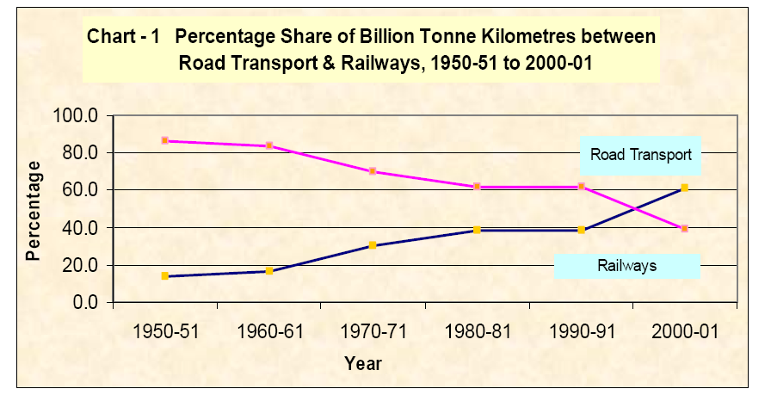

Slide 6
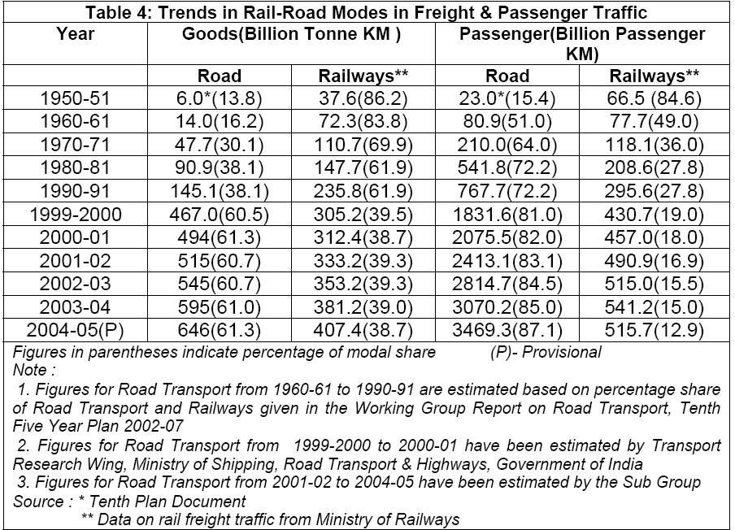

Slide 7
Historical analysis
Planning Commission, Government of India, had undertaken
  three Transport System Studies in the years 1978-79, 1986-87 and 2007-08 all of which were conducted by RITES.
  Thirty eight commodities are uniformly seen
  allows us to do a comparative analysis using categorization based on commodity characteristics.

Slide 8
Historical evolution of modal shares
Year | Total Originating Tonnes (MT) | Modal Shares in Total Originating Tonnes
 |  | Railways | Highways | Coastal Shipping | Airlines | Pipelines | IWT
1950-51 | 82.2 * | 73.2 (89%) | 9.0 (11%) | - | - | - | -
1978-79 | 283.40 ** | 184.70 (65%) | 95.60 (34%) | 3.10 (1%) | -
1986-87 | 484.9 ** | 255.40 (53%) | 224.00 (46%) | 5.50 (1%) | -
2007-08 | 2555.35 | 768.72 (30.08%) | 1558.87 (61.01%) | 59.10 (2.31%) | 0.28 (0.01%) | 113.50 (4.44%) | 54.88 (2.15%)

Slide 9
Historical analysis
1 | Ratio With Respect To Total Transport Demand |  | 1978-1979 | 1986-1987 | 2007-2008
 | ( i ) | Bulk | 0.594 | 0.598 | 0.485
 | ( ii ) | Non Bulk | 0.235 | 0.228 | 0.195
 | ( iii ) | Containersable High Value | 0.171 | 0.173 | 0.319
2 | Share - Bulk
 | ( i ) | Rail | 0.825 | 0.712 | 0.584
 | ( ii ) | Road | 0.174 | 0.287 | 0.416
3 | Share - Non Bulk
 | ( i ) | Rail | 0.483 | 0.377 | 0.136
 | ( ii ) | Road | 0.516 | 0.622 | 0.863
4 | Share - Containersable High Value
 | ( i ) | Rail | 0.321 | 0.173 | 0.074
 | ( ii ) | Road | 0.679 | 0.827 | 0.926
5 | Rate Of Growth Of Transport (%)
 | ( i ) | Bulk |  | 8.64 | 14.83
 | ( ii ) | Non Bulk |  | 7.94 | 15.94
 | ( iii ) | Containersable High Value |  | 8.85 | 39.99

Slide 10
Historical analysis
category | Volume of Demand (MT) |  |  | Demand in Billion NTKM |  |  | Average Lead (in km)
 | 1978-79 | 1986-87 | 2007-08 | 1978-79 | 1986-87 | 2007-08 | 1978-79 | 1986-87 | 2007-08
Bulk | 167 | 282 | 1117 | 119 | 186 | 613 | 715 | 660 | 548
Non bulk | 66 | 108 | 451 | 34 | 52 | 162 | 510 | 487 | 359
Containerisable | 48 | 82 | 736 | 31 | 51 | 418 | 639 | 627 | 567

Slide 11
Dominance of rail mode
Type & Category | 1978-79 | 1986-87 | 2007-08
Bulk
Non Bulk
Containerisable High Value

Slide 12
Value chain—historical analysis
Customer evolution
Evolution of services on IR
1950-60s—transportation
1960-70s-warehousing, local handling, documentation, transportation, local leads
1970-80s—all above+ packaging, inventory management
1980-90s-logistics
1990s-2000-logistics+value add manufacturing
2000 onwards—supply chain management
1950-60s—transportation
1960-1980s-warehousing, local handling, transportation, local leads
1980-1990s-- transportation, warehousing
1990’s onwards--transportation

Slide 13
Commodity wise modal share
Commodity | 1978-79 |  | 1986-87 |  | 2007-08
 | Rail | Road | Rail | Road | Rail | Road
Coal | 91 | 9 | 87 | 13 | 83 | 17
Food grains | 68 | 33 | 47 | 53 | 21 | 79
Iron Ore | 99 | 1 | 96 | 4 | 84 | 16
Limestone & Dolomite | 91 | 9 | 74 | 26 | 69 | 31
Mineral Oils | 72 | 28 | 65 | 35 | 22 | 78
Cement | 79 | 22 | 63 | 37 | 51 | 49
Chemical Manures | 70 | 30 | 61 | 39 | 67 | 33
Iron & Steel | 64 | 36 | 45 | 55 | 20 | 80
Salt | 70 | 30 | 63 | 37 | 42 | 58
Others | 36 | 64 | 21 | 79 | 8 | 92
Total | 66 | 34 | 54 | 46 | 33 | 67

Slide 14
Service requirements

Slide 15
Commodity Characteristics
Characteristic | Bulk | Non bulk | Containerisable
Primary
Parcel size | high | Medium to low | low
Propensity to damage during handling | low | high | high
Sensitivity to positioning on time | low | Medium to low | high
Intrinsic value | low | Medium to high | high
Need for specialized handling | low | medium | high
Derivatives
Perishability | low | medium | high
Value of goods | low | high | high
Need for add on services | low | medium | high
Reliability and flexibility | Low to medium | Medium to high | high

Slide 16
Rail transport elasticity
Based on past data
Sector-Wise Elasticity of Rail Traffic w.r.t GDP
Year | Rail Transport Elasticity
1991-92 to 2001-02 | .47
2001-02 to 2010-11 | .91
1991-92 to 2010-11 | .78
GDP Sectors / Commodity Movement by IR | Elasticity of Rail Tonnage w.r.t. GDP
 | 1991-92 to 2001-02 | 2001-02 to 2010-11 | 1991-92 to 2010-11
Agriculture / Foodgrains | 0.9 | 1.9 | 1.2
Mining & quarrying / Iron Ore & L & D | 0.7 | 1.1 | 0.9
Industry / Steel & POL | 0.5 | 0.5 | 0.5
Manufacturing / Other Goods | 0.9 | 1.5 | 2.0
Construction / Cement | 0.8 | 1.0 | 0.9
Electricity / Coal | 0.7 | 1.1 | 0.9
Rail Transport Elasticity
w.r.t. IIP
Mining & Quarrying | Manufacturing | Electricity | General
1.3 | 0.7 | 0.9 | 0.7

Slide 17
INFERENCES FROM GDP ANALYSIS
The rail elasticity vis-a-vis economic activity is less than equal to one when compared to overall GDP.
Rail elasticity tends to vary with the nature of sector and therefore growth in sectors where commodities are ‘Railable’ results in higher demand generation.
The rail elasticity would be influenced by what sectors rail mode attempts to service in large way.
what are “Railable “commodities will depend upon the congruence established between modal and commodity characteristics

Slide 18
Implications for transporters
different groups require different dimensions of service as the emphasized dimensions of quality and
therefore require differentiated services.
As the dimension of value of goods rises, the ability to charge for transportation is function of reliability and ability to give add on services.
Thus containersable cargoes are the most paying segment, followed by non bulk and finally bulk segment.

Slide 19
DOMINANCE OF RAIL IN PASSENGER TRANSPORT
TYPE AND CATEGORY | 1950-51 | 1978-79 | 1987-88 | 1997-98 | 2007-2008
LONG DISTANCE >1000KM
INTER CITY-300-800KM
SHORT DISTANCE
SUBURBAN
RURAL

Slide 20
Concerns - railways
Neglect of piecemeal traffic
Poor penetration of containerization
Line and terminal capacities
Mechanization of freight terminals
Security concerns
Poor project implementation
Asset reliability

Slide 21
Issues for Discussion
In what business we are in?
Do we estimate demand?
Who can help us in estimation of demand?
How do we cost services?
Do we need to change Mgmt/ orgn structure?

Slide 22
MAPPING OF PASSENGER SERVICES ON CUSTOMER DIMENSIONS
NON SUB
GENERAL
SUBURBAN
VERY LOW
LD
INTER CITY
REQUIREMENT OF ADD ON FACILITIES
REQUIREMENTS OF COMFORT
OVER NIGHT
PLD
VERY HIGH
VERY LOW
VERY HIGH
PRICE SENSITIVITY
TIME SENSITIVITY

Slide 23
MAPPING OF FREIGHT SERVICES ON CUSTOMER DIMENSIONS
DOCUMENTS
SMALLS
VERY HIGH
PROJECTS
PARCELS
CONTAINERIZED
HANDLING SENSITIVITY
TIME SENSITIVITY
INTRINSIC VALUE OF PARCEL
NON BULK
BULK
VERY LOW
VERY LOW
PRICE SENSITIVITY
VERY HIGH
VERY LOW
PARCEL SIZE
VERY HIGH

Slide 25
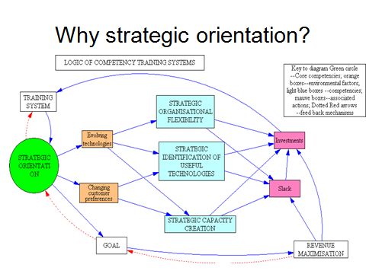

Slide 26
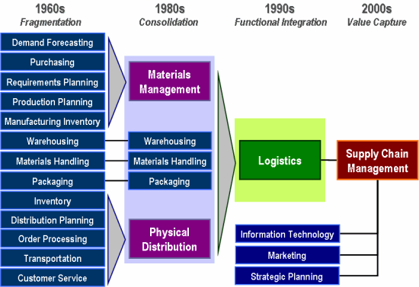
Evolution of logistics integration

Slide 27
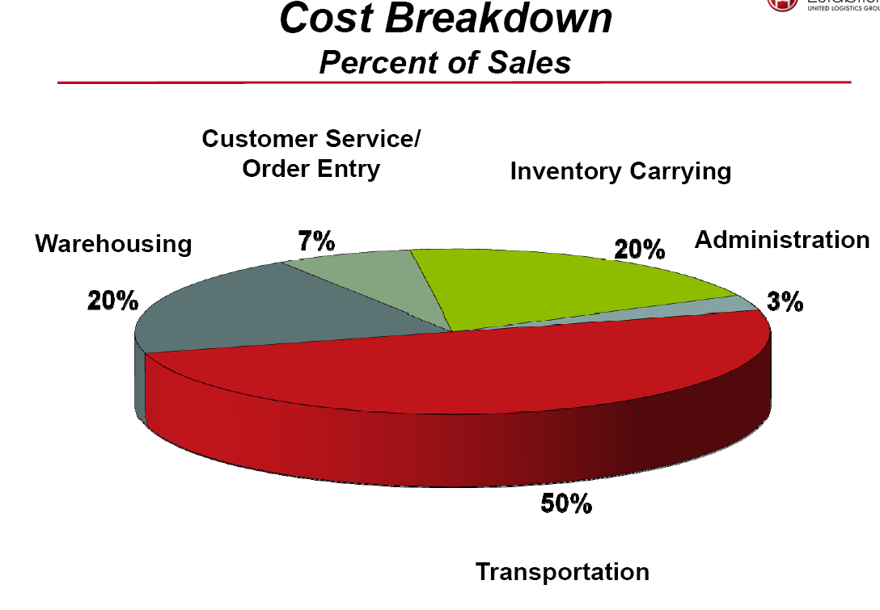

Slide 28
Multimodal transport in India
Was always there—not recognized
Lack of integrated services offering
Two drivers
  Containerization
  Globalization
Indian railways
  Pioneered containerization in India
    Domestic-1979
    international

Slide 29
Multi modal transport
Multi modal transport act—1991
Liberalization of institutions
  Customs
  Commerce
  Transport
  Ports
Spread of multimodal transport
  Acceptance of philosophy
  Spread of infrastructure
  Spread of handling systems
  Harmonization of procedures

Slide 30
Containerization—KPMG analysis in india
Key feature
Drivers of containerization
The EXIM container market in India has grown at a CAGR of 12 percent in the past five years, as compared to the 8–10 percent growth that other commodities such as POL, Iron ore and coal experienced during the same period. Growth in the container market is expected to continue in the medium term as a result of rising containerization levels and growth in trade. At 51 percent, the containerization level in India continue to fall short of that in developed countries, which have achieved significant levels of 70–80 percent
Increasing containerization of break bulk cargo
Growth of industries with containerisable cargo
Capacity creation –MLO terminals, logistics parks, DFC and industrial corridors
Thrust on developing container terminals

Slide 31
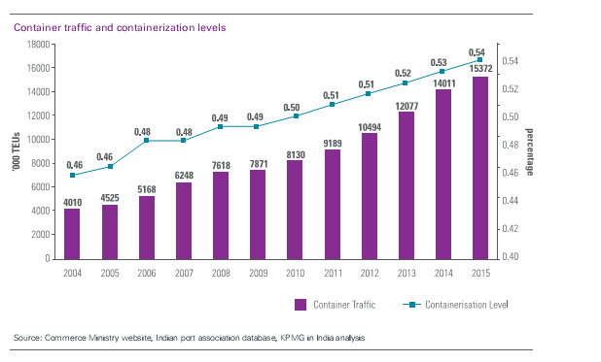
Containerization and handling

Slide 32
Status on date
Container penetration
  Overall 40-50%
  Likely 60-70% by 2030
  Regional imbalances
    West and south reached 70%
    East –only 10-15%
    Now progress shifted to deficient areas
  Increasing infrastructure
    Ports
    MMLPs
    Logistics corporation

Slide 33
WHY RAILWAYS
USP’S
  VERY HIGH DEGREE OF SAFETY
  GOOD SPEEDS POSSIBLE
  CAN MANAGE SCALE AND SCOPE AT THE SAME TIME
  CAN BE COST EFFECTIVE
  IS HIGHLY ENVIRONMENTALLY FRIENDLY
DEMAND FOR RAILTRAVEL
  AREA
  ECONOMIC ACTIVTY
  POPULATION
IN INDIA INDIAN RAILWAYS HAVE BENEFIT OF ALL THREE FACTORS
DEMAND IS NOT A CONSTRAINT
MULTIMODALISM ANSWER TO TRANSPORT AND LOGISTICS EFFICIENCY

Slide 34
Indicators of growing economy
Study by KPMG indicates(2013)
  1.8 trillion to 3.6 by 2020—economy
  Crude steel production –four times by 2030
  Demand for cement to double-2030
  Textiles industry -78 billion to 220 billion-2020
  Agriculture -300 million MT –2030
  Coal consumption =1100MMT -2020-35% imports
  EXIM cargo-890 MMT to 2800 MMT
  Middle class 160 million to 640 million—need finished goods—urban centers of consumption
All in all a growing manufacturing and service economy

Slide 35
Megatrends to affect economy
Changing demographics
  Urbanization
  60% urban population in 20-25 clusters-2030
  Industrial clusters need DFCs
Evolving requirements of trade
  Increasing retail, and manufacturing sectors
  Increased warehousing, niche industries
  Requirement of geography and commodity specific storages
Increasingly skewed modal mix
  Desired overlay of networks with hub and spoke configurations

Slide 36
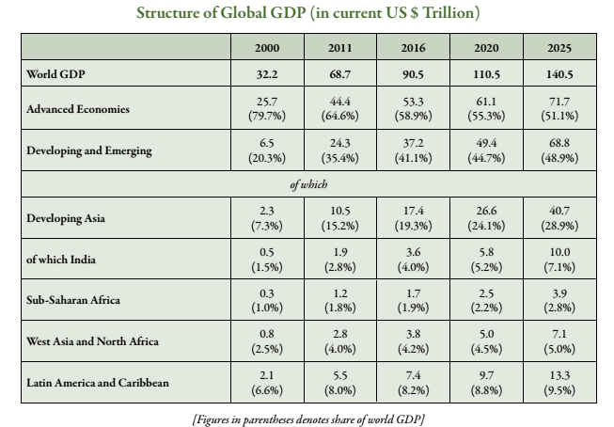
Indian perception position in world economy
Source –approach to 12 th plan planning commission

Slide 37
Key drivers of Indian transport system
Present
  Economic growth
  Globalization
  World trade patterns
  World Fuel prices
  Transport technologies
  urbanization
Future
  Fuel prices
  Alternate fuels
  Regional trade patterns
    Asia , china
    ASEAN
Global SCM integration
Expanding new markets
  South America
  BRICS
  AFRICA
Urbanization

Slide 38
Present directioning of transport
Strategic directioning of economy
  Faster , Sustainable and Inclusive growth
  Implications for transport
    Speed of transport
    Least social cost to nation
    Cover all areas of the country
Global perspective
  Integrated economy –integrated global logistics links

Slide 39
Directioning
Focus on
  Multimodal systems
    Containerization penetration
    Capacities at all places –ports, terminals, carriers, institutional systems
    Shift to logistics and supply chain practices
  on global linkages
    Open to all players—FDI
    Liberalization of trade
  Increase and balance share of railways
    DFC and capacity building
    Shift to logistics capacity building
  Reduce overall transport demand

Slide 40
Future evolution of transport
Passenger
  Land based integration
    Rail , road, shipping
  Tourism and business—drivers
  Possible harmonization of cultures or adaptation to provide country specific peoples demands
  Truly multi modal trips
    Locally
    Long distance
  Harmonized international and local systems
  Skill levels evolution
Private driven investments
Continuing urbanization
Freight
More and more localized
  power generation
    Ports
    Pithead
  Production systems
    SEZS and Ports
  Large logistics demand
    Intermediate products
  IT driven systems
  Skills differentiation
Last mile delivery
  Small vehicles—possible rail, waterways—local logistics
Private driven investments
Continuing urbanization

Slide 41
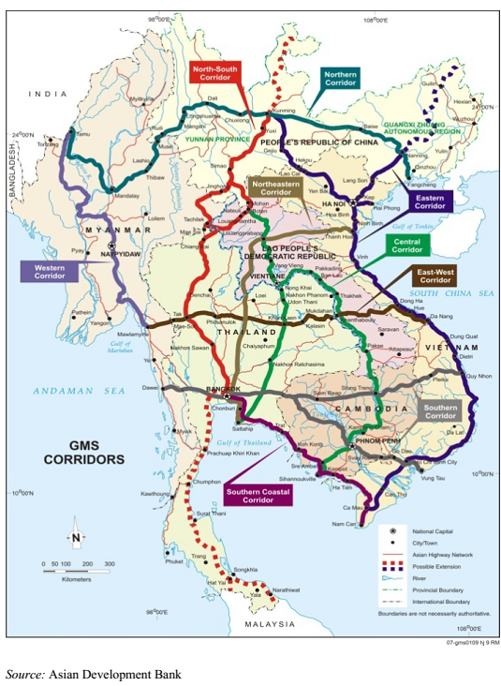

Slide 42
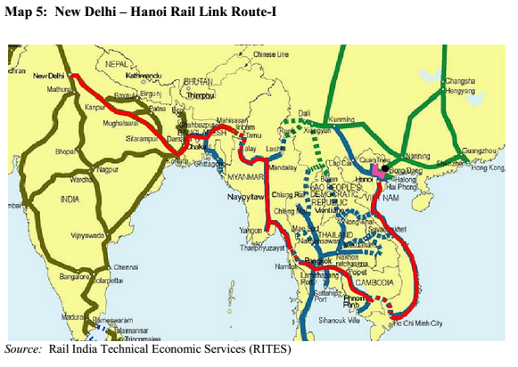

Slide 43
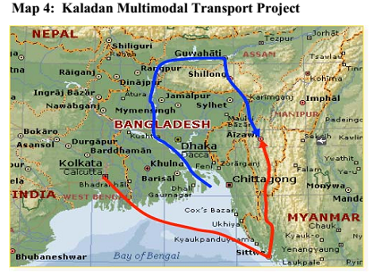

Slide 44
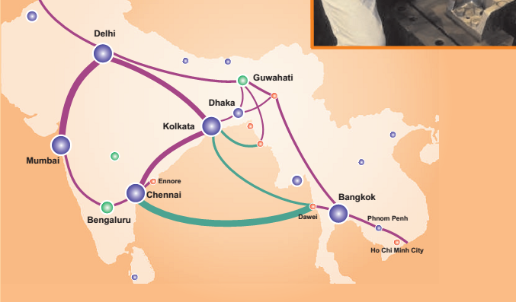
ASEAN India connectivity

Slide 45
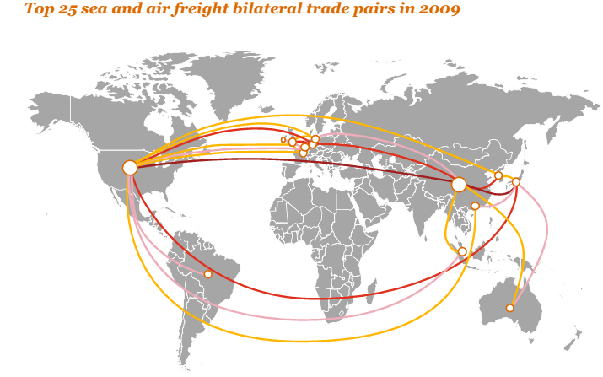

Slide 46
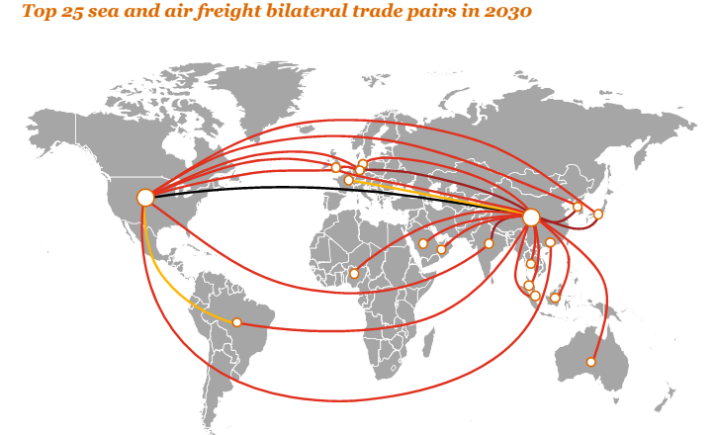

Slide 47

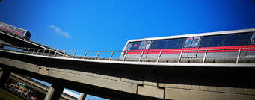
THANK YOU ANY QUESTIONS

