Slide 1
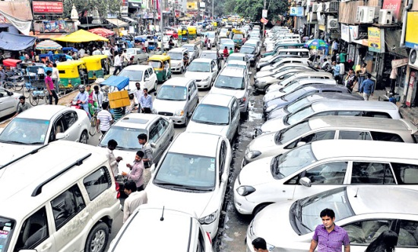
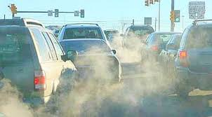
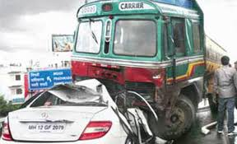
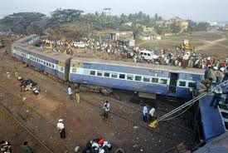
Social Cost of Transport Modes
Dr. Rachna Gangwar
Associate Professor, TAPMI School of Business
Manipal University Jaipur

Slide 2
The Transport Sector
Public investment in transport: 2.0 -2.5 percent of GDP (In India, 2.6% in 11th five year plan, 3.9% planned for 12th Five Year Plan)
40% investment of infrastructure is in transport
Transport contributes to 3-5% in economy, In India, 6.4% in 2008-09 (5% road, 0.9% rail)
Transport commonly accounts for 5-8%of total paid employment

Slide 3
The Transport Sector
Demand for freight and passenger transport in most developing and transition countries is growing 1.5 to 2.0 times faster than GDP
The estimated economic rate of return of projects in the transport sector is 20-22%, 50% higher than the Bank average

Slide 4
Costs of Building Transport Systems
Land
Construction (right of way, control systems)
Vehicles
Interest
Depreciation
Operations and maintenance

Slide 5
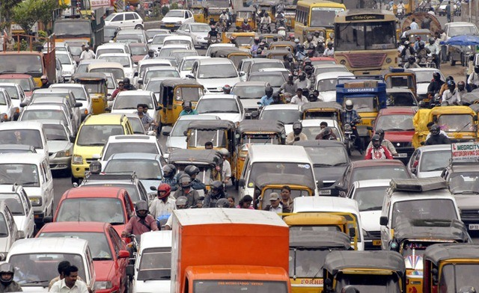

Slide 6
External Costs
Negative side effects of transport systems
Such side effects give rise to various resource costs that can be expressed in monetary terms:
  time costs of delays
  health costs caused by air pollution
  productivity losses due to lives lost in traffic accidents
  abatement costs due to climate impacts of transport

Slide 7
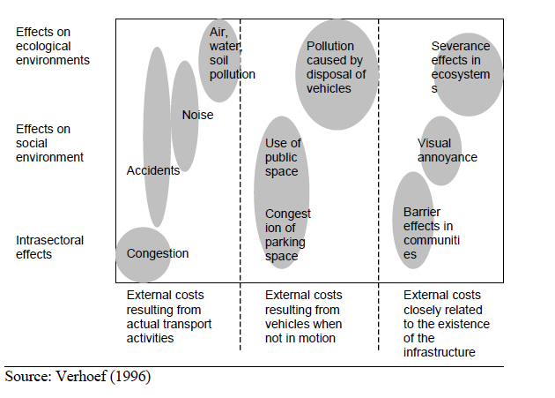
External Costs

Slide 8
External Costs
Air Pollution
  Carbon Monoxide (CO): 70-90% emissions
  Nitrogen Dioxide (NO₂): 45-50% emissions
  Hydrocarbons and Volatile Organic Compounds(HC/VOC): 40-50% emissions
  Carbon Dioxide (CO₂): 70-90% emissions
Water Pollution
  Air pollution fallouts
  Marine vessel discharges and spills
  Construction of infrastructure
Noise pollution

Slide 9
External Costs
External costs of transport are generally not borne by transport users and hence not taken into account when they make a transport decision

Slide 10
Internalization
Is a way to give transport users the right incentives
The internalization of external costs can done through
  regulation, i.e. command and control measures
    Emission standards, process specification, product specification, institutional regulation
  market-based instruments (e.g. taxes, charges, emission trading, etc.)

Slide 11
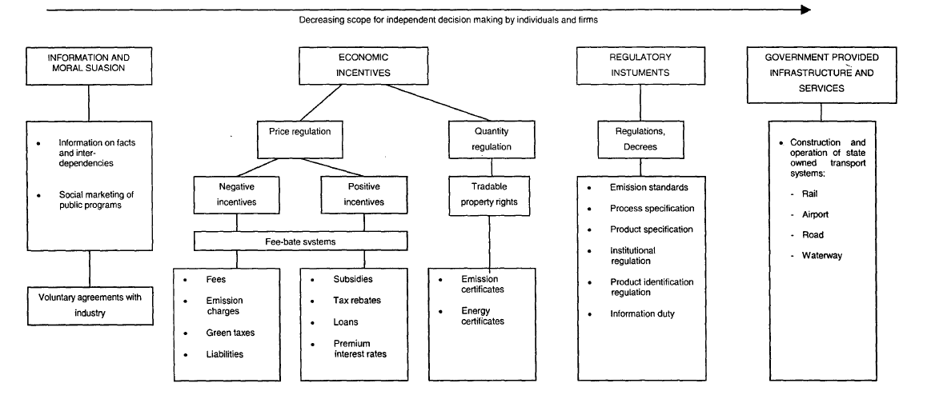
Policy Instruments for Internalizing External Costs

Slide 12
Private (or internal costs)
Directly borne by transport users
  costs of depreciation and maintenance of vehicles
  costs of insurance
  fuel costs
  own time costs
  transport fares
  transport taxes and charges
Market mechanism charges these costs directly to the users

Slide 13
Government Expenditure
Construction and maintenance of infrastructure (including facilities for the environment and traffic safety such as noise barriers and wild life viaducts)
Traffic duties of police and justice
Other government activities (license registration etc)
Public transport subsidies
Other transport related government expenditures

Slide 14
Indian Railways: Subsidies
Carriage of essential commodities at below cost
Passenger and other coaching service at below cost and loss in suburban services, uneconomic branch lines
Freight concession on relief materials, other obligations such as education, security etc

Slide 15
Government Expenditure
Internal, if taken into account by users while making transport decisions
External, if not taken into account by users while making transport decisions
Some components are internalized in
  Public private partnership projects
  Private projects

Slide 16
Social Costs
All costs occurring due to the provision and use of transport infrastructure
Sum of internal, external and government expenditures
Social costs = Internal costs + external costs + (government expenditure)

Slide 17
External Cost Estimates in EU
As per UIC study, the total external cost of transport in the EU-27 plus Norway and Switzerland in 2008 amount to more than € 500 billion (4% of the total GDP of EU)
About 77% of the costs are caused by passenger transport and 23% by freight
The annual congestion cost of road transport delays amount to between € 146 and 243 billion (1 to 2% of the total GDP)

Slide 18
External Cost Estimates in EU
Largest share of costs by road (93%)
  large share of road in the overall transport volume
  higher average external costs per passenger-km or ton-km

Slide 19
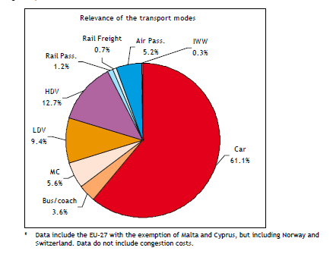

Slide 20
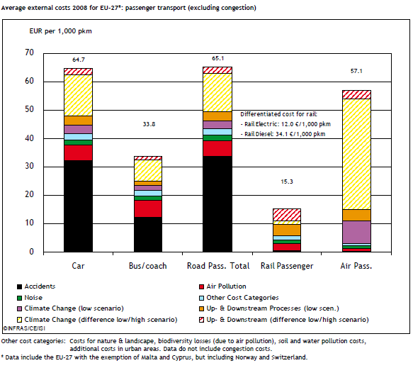

Slide 21
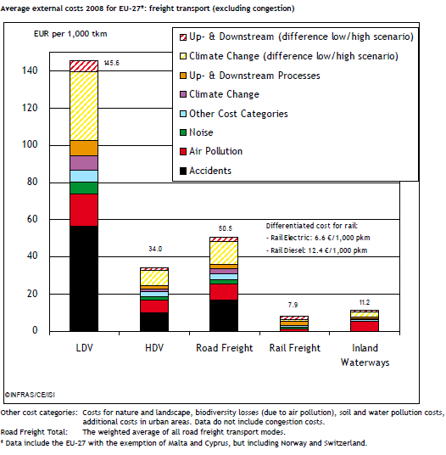

Slide 22
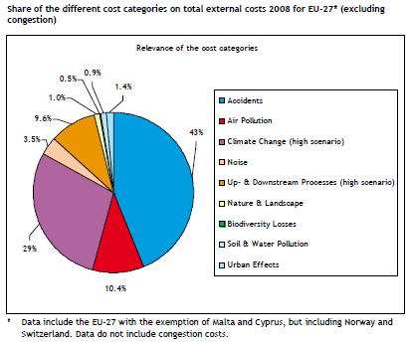

Slide 23
External Cost Estimates in Japan
The social costs of vehicular transport are about 8 per cent of GDP. Fuel tax for cars covers only 16.3 per cent of the social costs of regular car use
The traffic congestion component represents more than 45 per cent of the total social cost of vehicular transport.
Cost due to global warming accounts for 5–11 per cent of the total costs

Slide 24
External Costs Estimates in India
Total costs not available
Modal share (in pkm and ntkm)
  Passenger: road – 86%, rail – 13%, air – 1%
  Freight: road – 52%, rail – 35%, pipeline – 7%, coastal shipping – 5%
Road dominant mode for passenger and freight transport
Studies have been done to estimate accident and pollution costs

Slide 25
Social Cost of Accidents
Direct and indirect costs of injuries, deaths and damage
Difficulty of putting monetary values on pain and suffering

Slide 26
Social Cost of Accidents
Costs associated with injuries: costs to victims, families, government, insurers, and taxpayers and property damage suffered by all
Other resource costs: police, fire, legal/court, and victim services (e.g., foster care, child protective services), plus the costs of property damage or loss in injury incidents

Slide 27
Social Cost of Accidents
Work loss costs: victims' lost wages and the replacement cost of lost household work, fringe benefits and the administrative costs of processing compensation for lost earnings through litigation, insurance, or public welfare programs like food stamps and Supplemental Security Income.
Quality of life: the value of pain, suffering, and quality of life loss to victims and their families.

Slide 28
Social Cost of Accidents
As per World Bank estimate, in most countries, costs exceed 1 per cent of GDP
OECD estimated the cost as 2% of GDP for OECD countries
India’s record in road safety is very poor

Slide 29
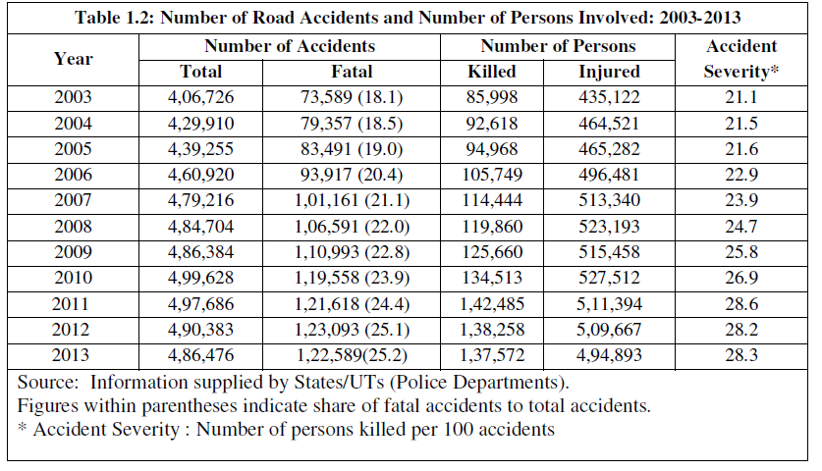
Road Accidents in India

Slide 30
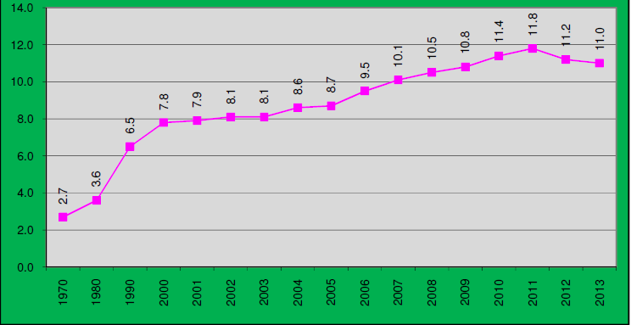
Number of Persons Killed per Lakh Population

Slide 31
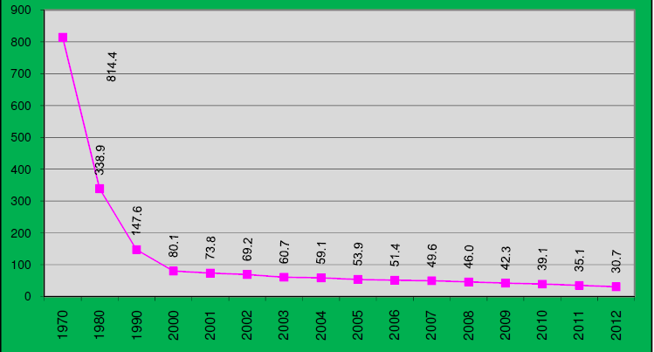
Number of Road Accidents per Ten Thousand Vehicles

Slide 32
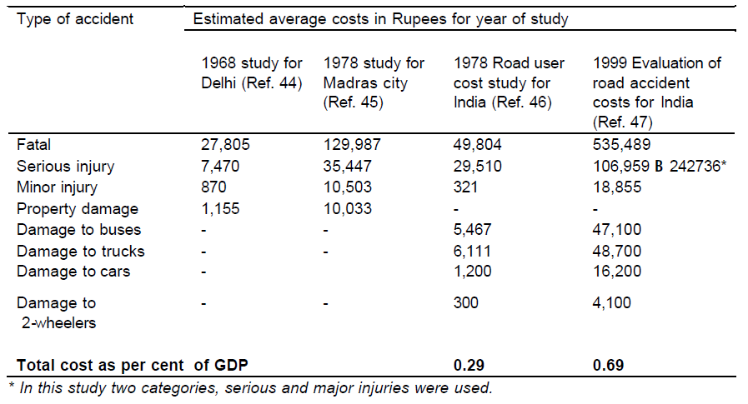
Road Accidents in India

Slide 33
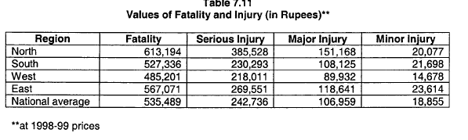
TCS Study

Slide 34
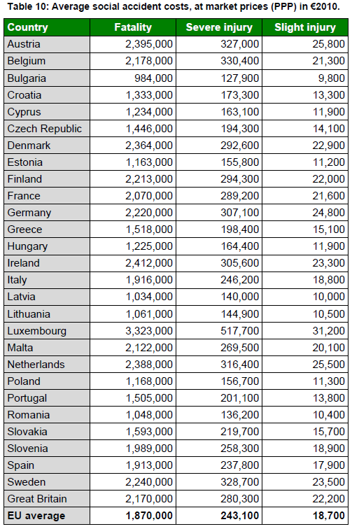

Slide 35
TCS Study
Cost of a fatal accident (sum of)
  Gross loss of future output
  Notional value of pain, grief and suffering (as a percentage of gross output loss)
  Hospital expenditure
  Loss of earnings during hospitalization
  Lawyers' fees
  Surveyors' fees
  Administrative expenses by police, insurance companies and courts
  Relatives‘ costs.

Slide 36
TCS Study
Cost of damages to vehicle (sum of)
  Repair charges of the damaged vehicle
  Wages of the crew
  Surveyors' fees
  Administrative expenses of insurance companies

Slide 37
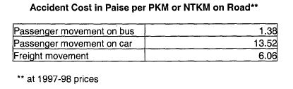
TCS Study

Slide 38
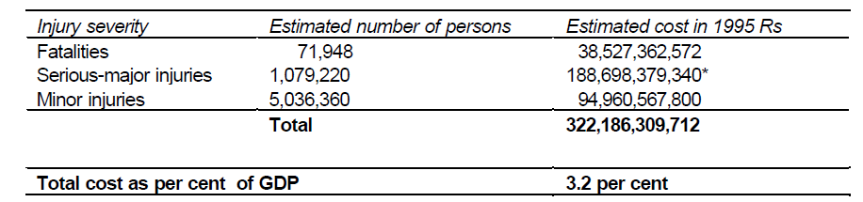
Social Cost of Road Accidents
Source: Study by Prof Dinesh Mohan, 2002

Slide 39
Social Cost of Road Accidents
The value could be higher than 3.2% because
  Official estimates could be underestimated
  Fatality: serious injury: minor injury ratio
  Cost of medical treatment from government hospital or private hospital
  Minor injury and damage only accidents
  Life expectancy at birth or life expectancy at 5

Slide 40
Rail Accidents in India
Number of passenger killed in rail accidents in 1995: 406 (compared to ̴ 72,000 in road accidents)
    5-6% of road, considering road share
Injured: 681 (compared to over 6 millions in road accidents)

Slide 41
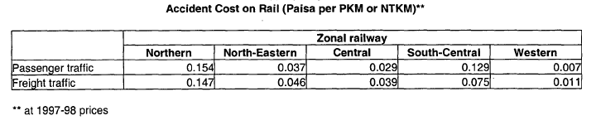
Social Cost of Accidents (Road and Rail)

Slide 42
Air Pollution
To estimate health impact cost from CO, NOX, SO₂/SOX and TSP
Basis is McCubbin and Delucchi, 1999, and Delucchi, 2000 studies: the US dollar costs of the health impact per kg of the relevant pollutants have been worked out through a detailed methodology
Adjusted the US dollar costs, given in 1991 prices per kg of pollutant emission

Slide 43
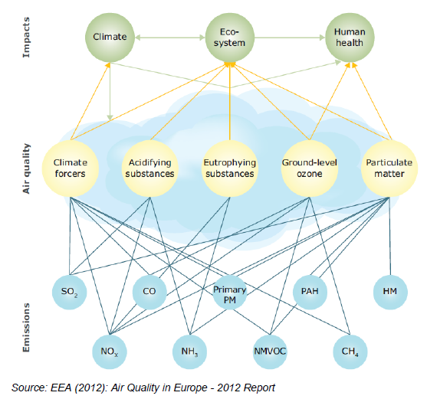

Slide 44
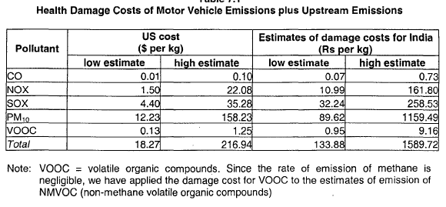
Air Pollution

Slide 45
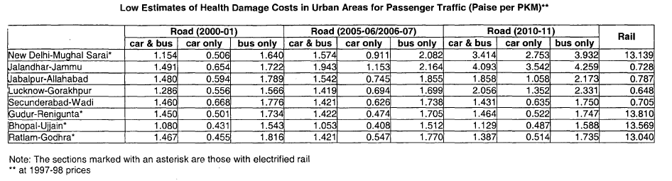
Air Pollution
For electric traction on rail, the damage cost per PKM/NTKM refers to emissions from thermal plants in urban areas only.
Assumption: 1/3 thermal plants in urban areas

Slide 46
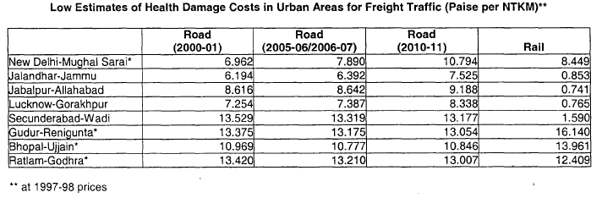
Air Pollution

Slide 47
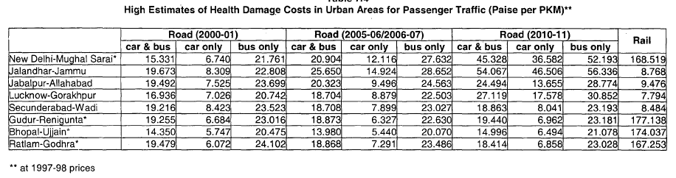
Air Pollution

Slide 48
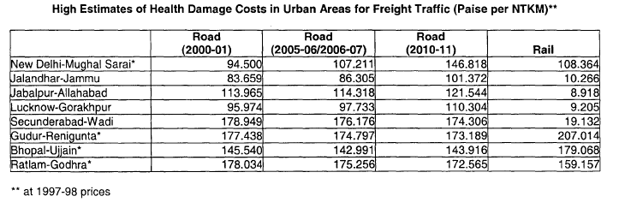
Air Pollution

Slide 49
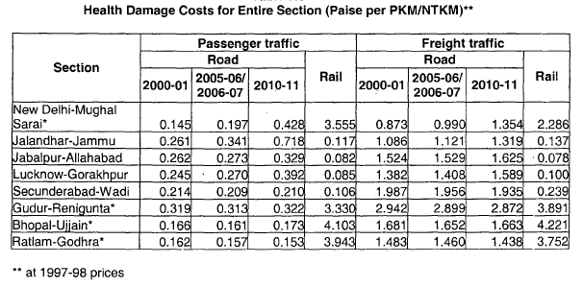
Air Pollution

Slide 50
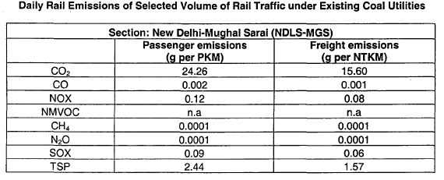
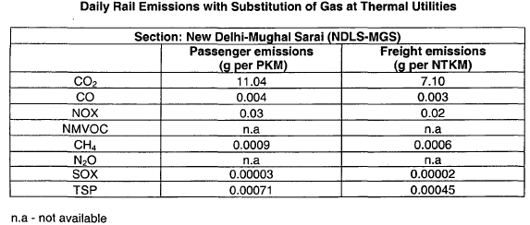
Air Pollution

Slide 51
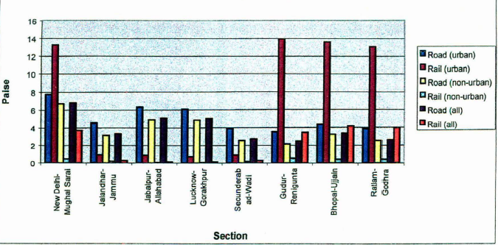
External Costs of Passenger Transport in 2000-01 (Rs/PKM)

Slide 52
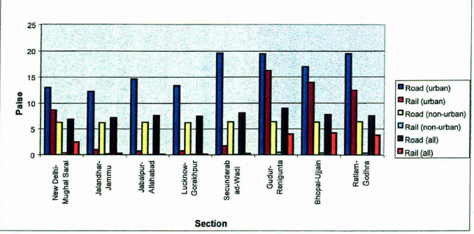
External Costs of Freight Transport in 2000-01 (Rs/NTKM)

Slide 53
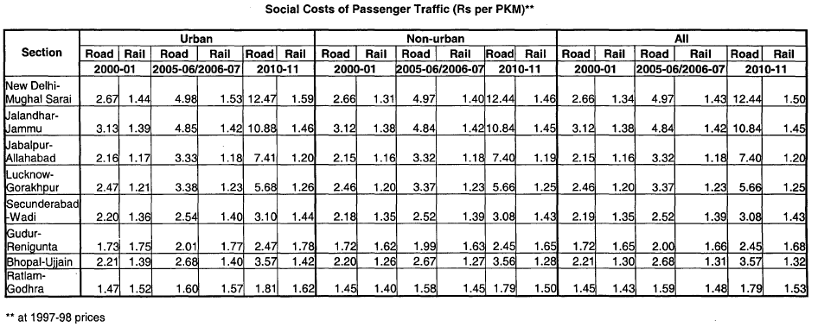
Social Costs of Passenger Transport (Rs/PKM)

Slide 54
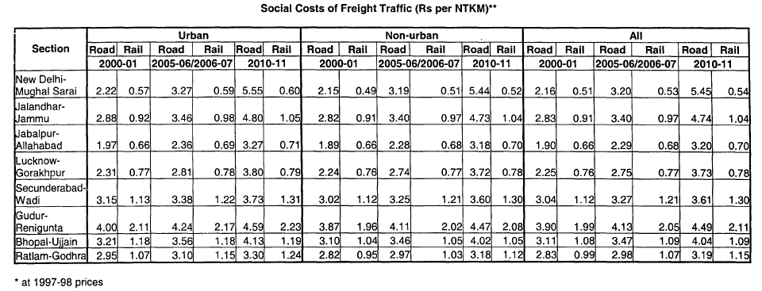
Social Costs of Freight Transport (Rs/NTKM)

Slide 55
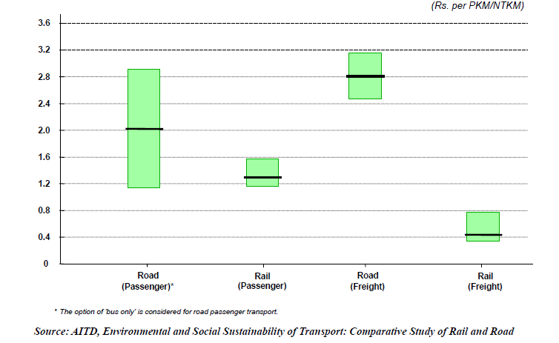
Social Costs

Slide 56
Health Damage Costs in Delhi
Sengupta and Mandal (2002) estimated that the annual health damage cost for Delhi worked out to be Rs. 269 crore in 2000–2001 under low estimates
The corresponding estimate under high-cost scenario was Rs. 3689 crore

Slide 57
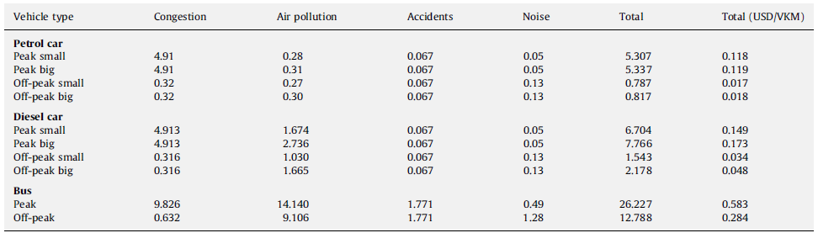
Total marginal external costs of urban transport – Delhi (Rs./VKM).

Slide 58
Policy Implications
Regulation/command and control measures (cleaner fuels)
Market Mechanism (taxing fuel, vehicle registration fee, parking charges etc.)
Better vehicle technology
Public transport subsidy
Encouraging alternatives to transport
  Videoconferencing, teleshopping, internet shopping
Reducing road space
Modal shift in favor of rail based transport systems
Promotion of non-motorised transport (bi-cycle lanes, footpaths)

Slide 59
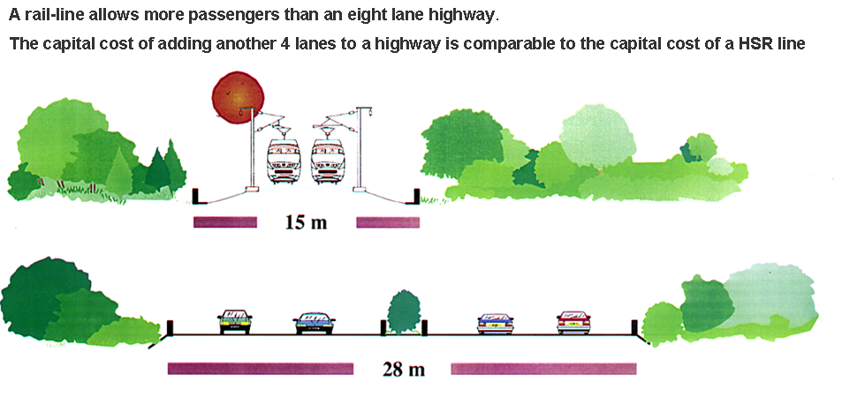
Rail Advantage: Land Requirement

Slide 60
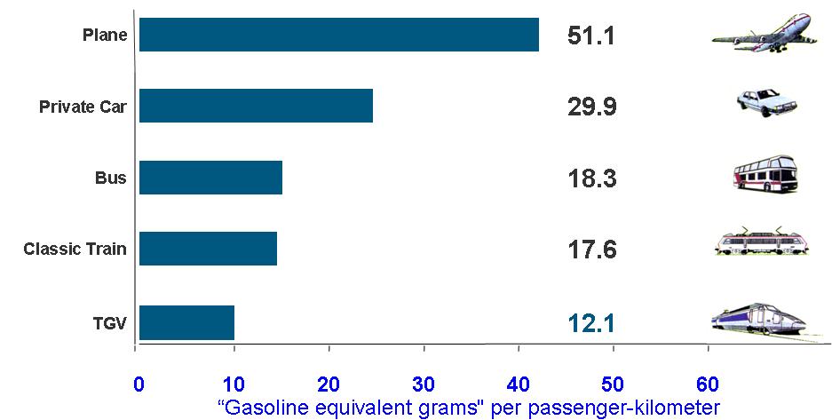
Rail Advantage: Gasoline Equivalent per passenger km

Slide 61
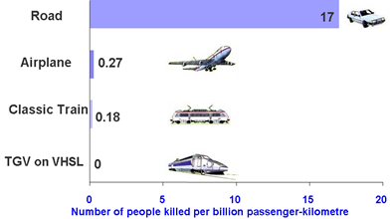
Rail Advantage: Accidents

Slide 62
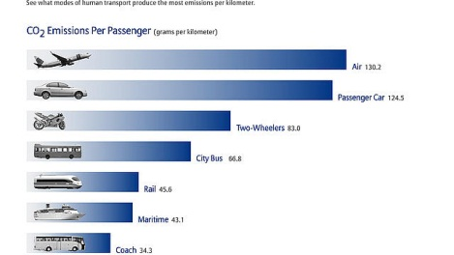
Rail Advantage: CO₂ Emissions per passenger

Slide 63
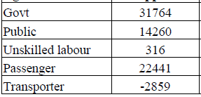
Economic Benefits from Delhi Metro
Savings in Rs Million

Slide 64
Thank You

Slide 65
Delhi Metro: Investment
Investment of Metro: Im
Investment reduced due to Metro
    Private buses: Ibpri
    Public buses: Ibpub
    Personal vehicles (cars and two-wheelers): Ipv
    Savings in Investment Cost of Road Infrastructure: Iri

Slide 66
Delhi Metro: Operation and Maintenance (O&M) Charges
O & M charges of Metro: Om
O & M charges reduced due to Metro due to fewer vehicles on road and decongestion
    Private buses: Obpri
    Public buses: Obpub
    Personal vehicles (cars and two-wheelers): Opv

Slide 67
Delhi Metro: Revenue
Revenue of Metro: Rm
Tax Revenue to Government: Rt
Revenue loss due to Metro
    Private buses: Rbpri
    Public buses: Rbpubfit

Slide 68
Delhi Metro: Benefits
Reduction in pollution: Bpp
  Due to reduction in number of vehicles on road
  Due to reduction in congestion on roads
Savings in travel time: Bstt
  Due to reduction on congestion on roads
  Due to reduction in travel time for Metro passengers
Reduction in accidents: Bra

Slide 69
Road Taxes in India
Central VAT (CenVAT) and the Central Sales Tax (CST) levied by the Central Government
Motor vehicles tax, passengers and goods tax, State VAT, entry tax, and toll taxes levied by the State governments
Octroi levied by the local bodies

